Slide 1
SEMINAR ON THE BENEFITS OF
PLANT VARIETY PROTECTION
Benefits of plant variety protection for
breeders, farmers and society
Peter Button Vice Secretary-General, UPOV September 20, 2018
Sofia, Bulgaria

Slide 2
Preview
Diversity in plant breeding to deliver maximum benefits for farmers
Making new varieties available to farmers
Examples of how farmers and society have benefited in UPOV members

Slide 3
CROPS
LARGE
PUBLIC
(GOVT.)
COMMUNITY
INTERNATIONAL
FOREIGN
NATIONAL
LOCAL
INDIVIDUAL
SMALL
TYPE OF VARIETY
PRIVATE

Slide 4
The international perspective
INTERNATIONAL
FOREIGN
NATIONAL
LOCAL

Slide 6
HOW TO BECOME A MEMBER OF UPOV
State/Intergovernmental Organization must:
Have a law which conforms to the UPOV Convention
Ask advice of the Council of UPOV
If advice positive: deposit instrument of accession

Slide 8
UC Davis Strawberry Licensing Program - leader in California & World
Strawberry Industry in California:$2.2 B
Represent 75% California production
Leader, position #1, global level
In 25 years, Spanish Strawberry Industry grew up to $1B
Transfer of varieties & know-how
70-90% UC Davis varieties

Slide 9
Representative PBR filings for UC Davis strawberry varieties
Argentina PBR
Australia PBR
Belarus PBR
Brazil PBR
Canada PBR
Chile PBR
China PBR
Colombia PBR
Ecuador PBR
EU PBR
Israel PBR
Japan PBR
Jordan PBR
Mexico PBR
Morocco PBR
New Zealand PBR
Peru PBR
Republic of Korea PBR
South Africa PBR
Switzerland PBR
Tunisia PBR
Turkey PBR
Uruguay PBR

Slide 10
Domestic
Foreign
BREEDERS
BREEDERS
Breeder’s Exemption
NEW VARIETIES
NEW VARIETIES
FARMERS, GROWERS
FARMERS, GROWERS
CONSUMERS
CONSUMERS

Slide 11
Preview
Diversity in plant breeding to deliver maximum benefits for farmers
Making new varieties available to farmers
Examples of how farmers and society have benefited in UPOV members

Slide 12
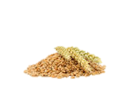
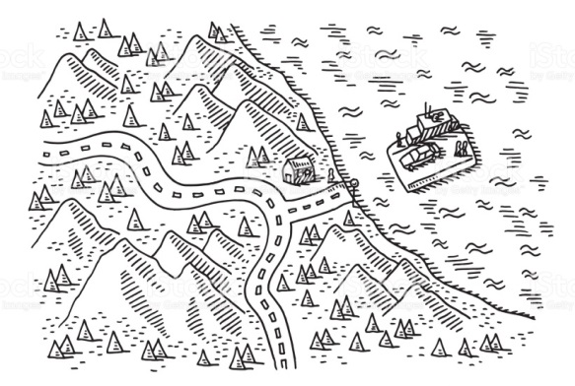
PRIVATE SECTOR
PUBLIC SECTOR
BREEDERS
International Breeding (Institute)
National Breeding Institute
Large enterprises (e.g. companies, cooperatives)
SME’s
Individuals (e.g. farmers)
SEED PRODUCERS / PLANT PROPAGATORS
PBR LICENCES
SEED
INFORMATION
PRODUCTION & DISTRIBUTION
DISTRIBUTORS
SEED
SEED
SEED
SEED
SEED
SEED
SEED
FARMERS

Slide 13
Preview
Diversity in plant breeding to deliver maximum benefits for farmers
Making new varieties available to farmers
Examples of how farmers and society have benefited in UPOV members

Slide 14
Benefit of Society
Food security
Climate change
Economy
Environ-ment
Technology transfer
Farmer benefits
Export
Better,
cheaper
food
Adapted crops
Sustainable production
Usable technology (varieties)
International
competitiveness
Reduce
high cost
imports
Less inputs
Public Private Partner-ships
Rural employ-ment
New, improved varieties

Slide 15
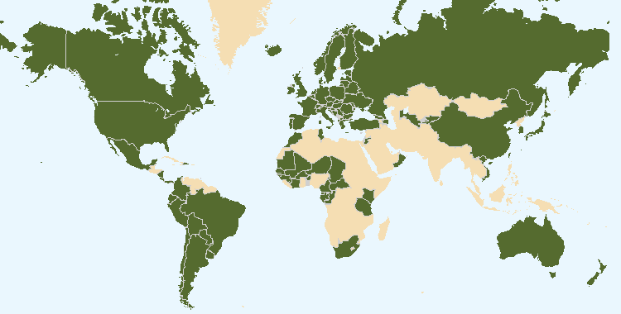
The boundaries shown on this map do not imply the expression of any opinion whatsoever on the part of UPOV concerning the legal status of any country or territory
Food security
Climate change
Economy
Environ-ment
Technology transfer

Slide 16
2000-2013

Slide 17
EU: 2000-2013
Without plant breeding:
EU would have moved from being net EXPORTER to net IMPORTER in all major agricultural crops (including wheat and barley)

Slide 18
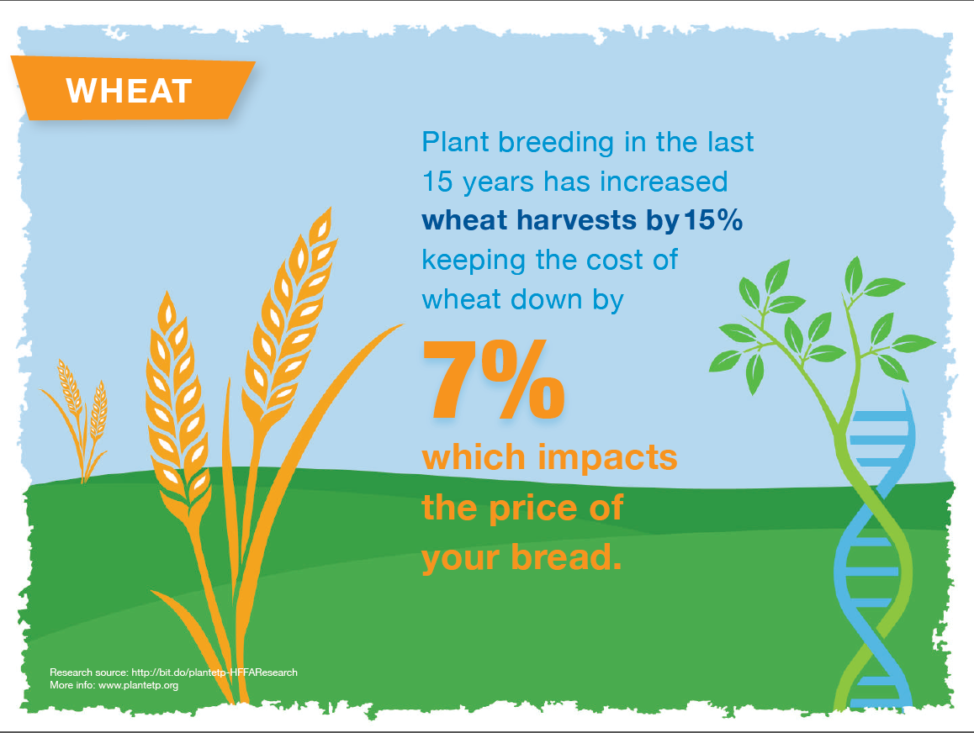

Slide 19
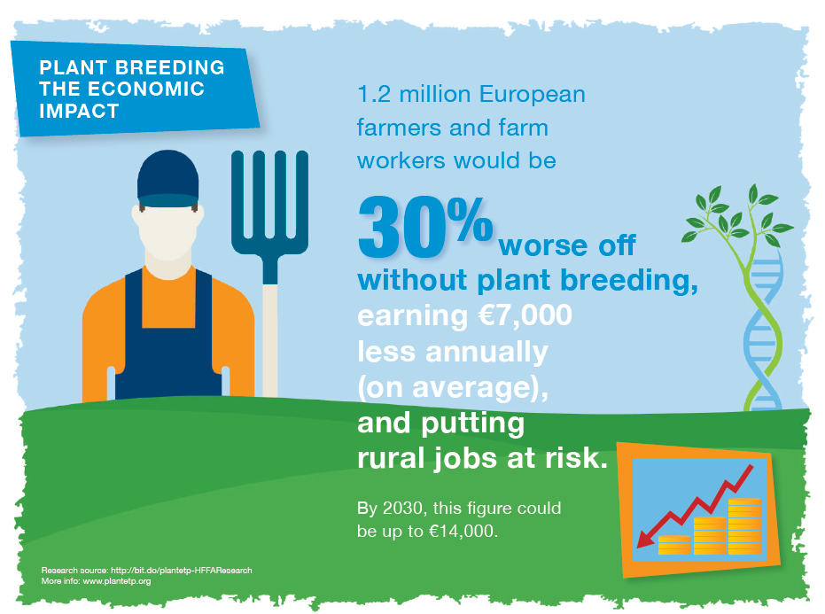

Slide 20
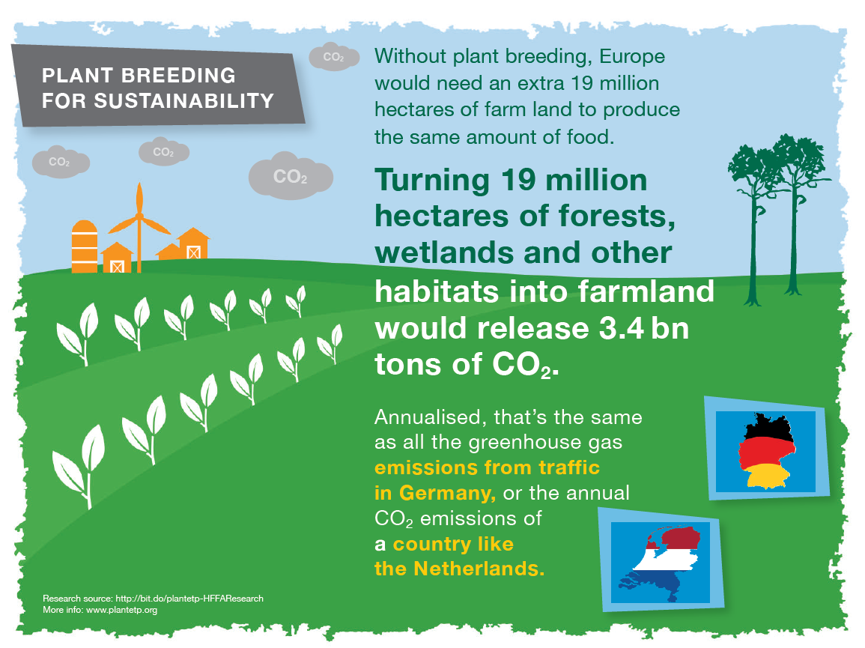

Slide 21
The boundaries shown on this map do not imply the expression of any opinion whatsoever on the part of UPOV concerning the legal status of any country or territory
Food security
Climate change
Economy
Environ-ment
Technology transfer

Slide 22
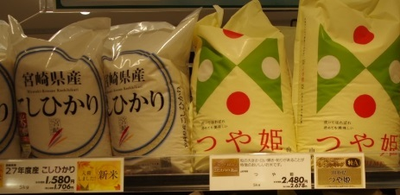
High Level Study Tour (Japan, July 2016)
Koshihikari (1,580 ¥)
Tsuyahime
(2,480 ¥)

Slide 23
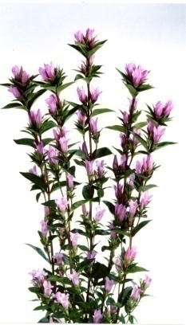
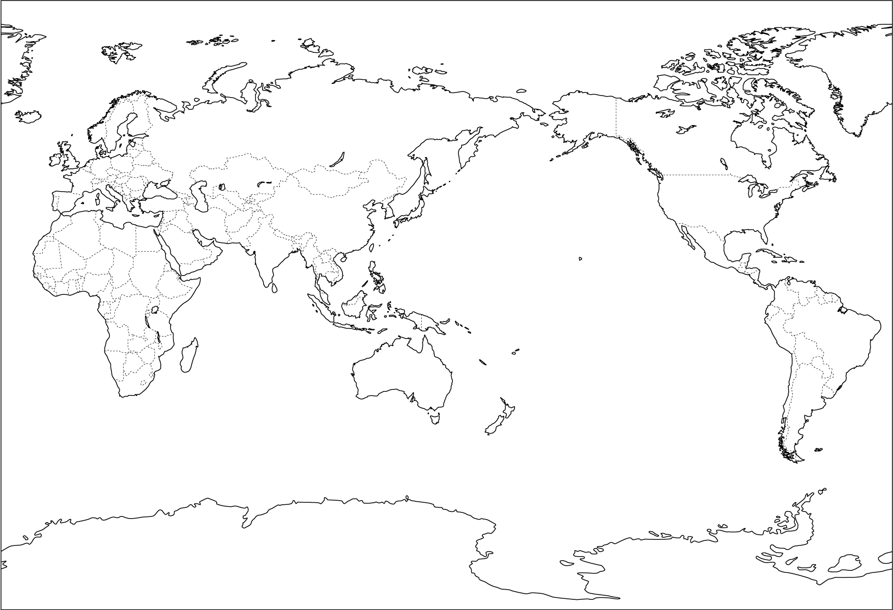
World Branding Strategy of “Ashiro” Rindo based on PBR
EU
Supply through the year
USA
Lovely Ashiro
Japan
Supply of propagating material
Export of cut flowers
Chile
New Zealand
Yasunori Ebihara, International Symposium (Seoul, August 2009)

Slide 24
The boundaries shown on this map do not imply the expression of any opinion whatsoever on the part of UPOV concerning the legal status of any country or territory
Food security
Climate change
Economy
Environ-ment
Technology transfer

Slide 25
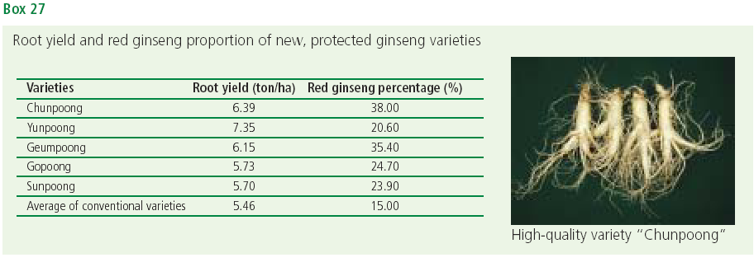
Republic of Korea
Medicinal plants

Slide 26
Domestic
Foreign
BREEDERS
BREEDERS
Breeder’s Exemption
NEW VARIETIES
NEW VARIETIES
FARMERS, GROWERS
FARMERS, GROWERS
CONSUMERS
CONSUMERS

Slide 27
Republic of Korea
Application Ratio of Residents/Non Res.
Dr. CHO, Il Ho (Symposium on Plant Variety Protection - Future Strategy for Enhancing the Effectiveness of the PVP System, Seoul July 13, 2011)
Notes:
27

Slide 28
KSVS Symposium on Plant Variety Protection
Seoul, Republic of Korea (September 3, 2015)

Slide 29
The boundaries shown on this map do not imply the expression of any opinion whatsoever on the part of UPOV concerning the legal status of any country or territory
Food security
Climate change
Economy
Environ-ment
Technology transfer

Slide 30
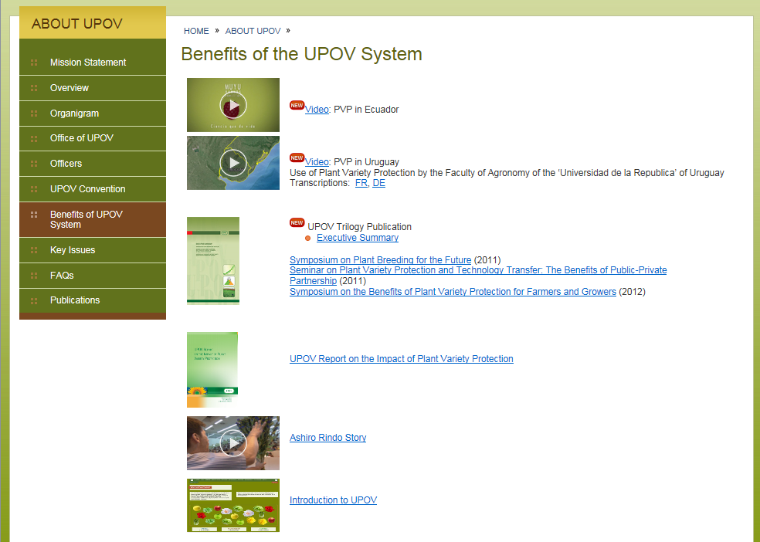
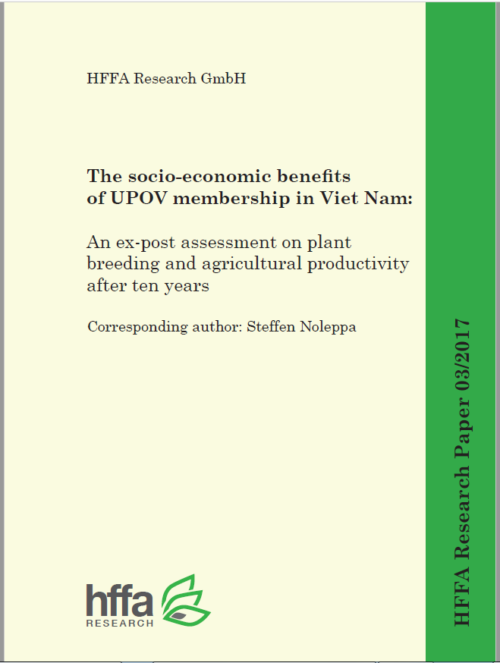

Slide 31
STUDY in VIET NAM*
Annual land productivity developments since Viet Nam joined UPOV in 2006 in Rice, Corn (maize) and Sweet Potatoes
1995-2005: increase in yield mainly through increased level of inputs – no detectable increase due to plant breeding
2006-2016: annual land productivity increase due to plant breeding
Rice 1.7 %
Corn 2.1 %
Sweet potatoes 3.1 %
* “The socio-economic benefits of UPOV membership in Viet Nam; An ex post assessment on plant breeding and agricultural productivity after 10 years” (Corresponding author: Steffen Noleppa) by HFFA Research GmbH

Slide 32
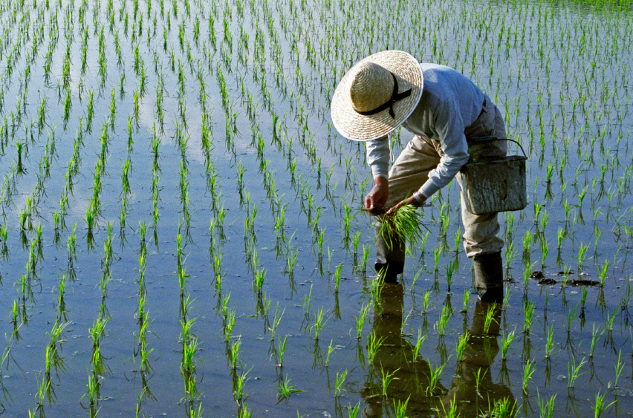
STUDY in VIET NAM
Without those developments since 2006, current annual yields in Viet Nam would be lower by:
Rice 16 %
Corn 19 %
Sweet potatoes 27 %

Slide 33
IMPACT OF PVP/UPOV SYSTEM ON VN’S AGRICULTURE
NGUYEN THANH MINH, PVPO, MARD/VIETNAM
PHILLIPINES, August - 2018

Slide 34
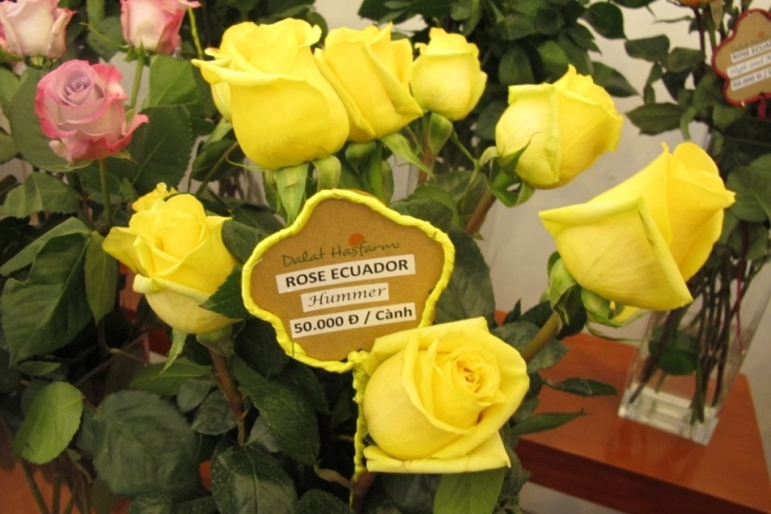
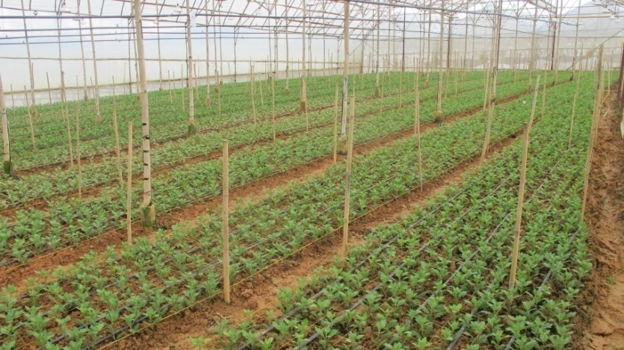
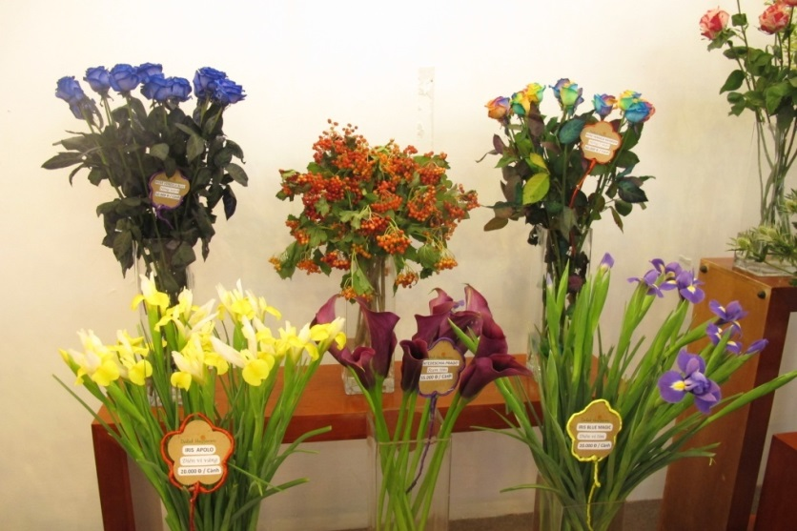
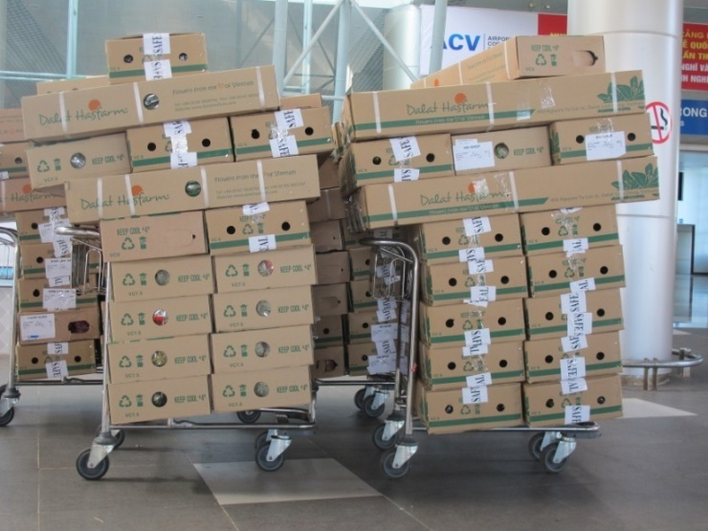
Increasing farmer’s income
Specialization in value chain
New rose can be more expensive than old 10 to 15 times
Farmer produce under license from Owners

Slide 35
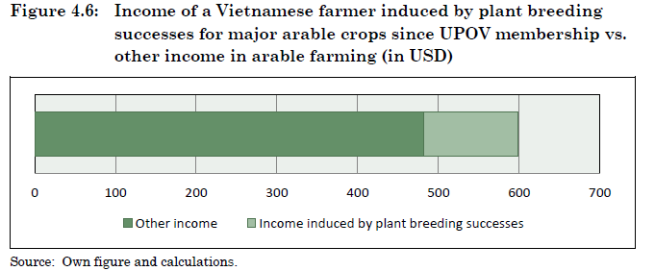
STUDY in VIET NAM
INCOME of Vietnamese farmers has increased by 24% since 2006

Slide 36
STUDY in VIET NAM
Annual value added:
Arable farming $2.3 billion
Horticulture $1.0 billion
Floriculture $ 0.2 billion
GDP added upstream/downstream (value chains)
$1.5 billion
TOTAL ADDED: $5 billion
(> 2.5% GDP)

Slide 37
Applications for Plant Breeders’ Rights
Erizal Jamal, Director, Center for Plant Variety Protection & Agriculture Permits, Indonesia. 10th East Asia Plant Variety Protection Forum Meeting
Dr. Mary Ann P. Sayoc, President, Philippine Seed Industry Association. National Seminar on Benefit of The Plant Variety Protection System, Philippines (11th EAPVP ), August 2, 2018
Sri Ikarostika Rahayu Binti Muhammad Ghazi. Department Of Agriculture, Malaysia. National Seminar on Benefit of The Plant Variety Protection System, Philippines (11th EAPVP ), August 2, 2018
Nguyen Thanh Minh, PVPO, Mard/Viet Nam. National Seminar on Benefit of The Plant Variety Protection System, Philippines (11th EAPVP ), August 2, 2018

Slide 38
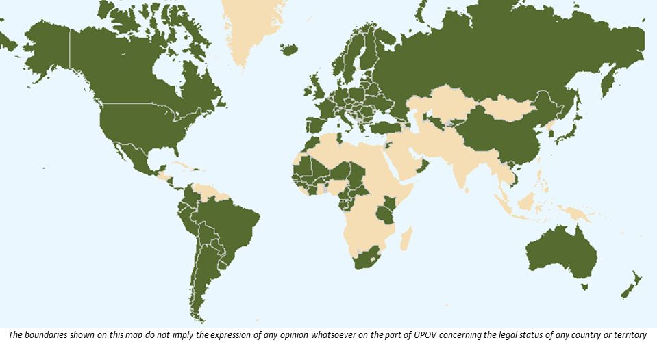
Food security
Climate change
Economy
Environ-ment
Technology transfer

Slide 39
Impact of Plant Variety Protection in Kenya
65 Billion Kenya Shillings = $645 million (approx. Aug. 2018)
CUT FLOWER EXPORTS 1995 - 2013
Source: HCDA

Slide 40
CUT FLOWER EXPORTS 1995 - 2013
Source: HCDA
Source: KEPHIS

Slide 41
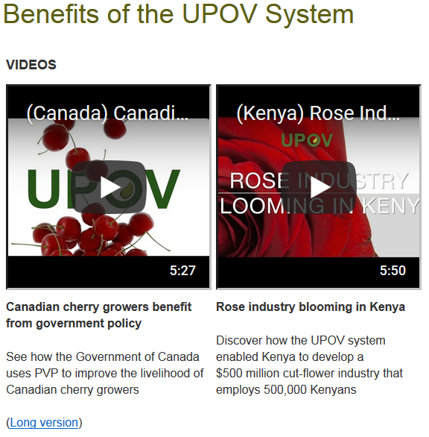

Slide 42
Food security
Climate change
Economy
Environ-ment
Technology transfer

Slide 43
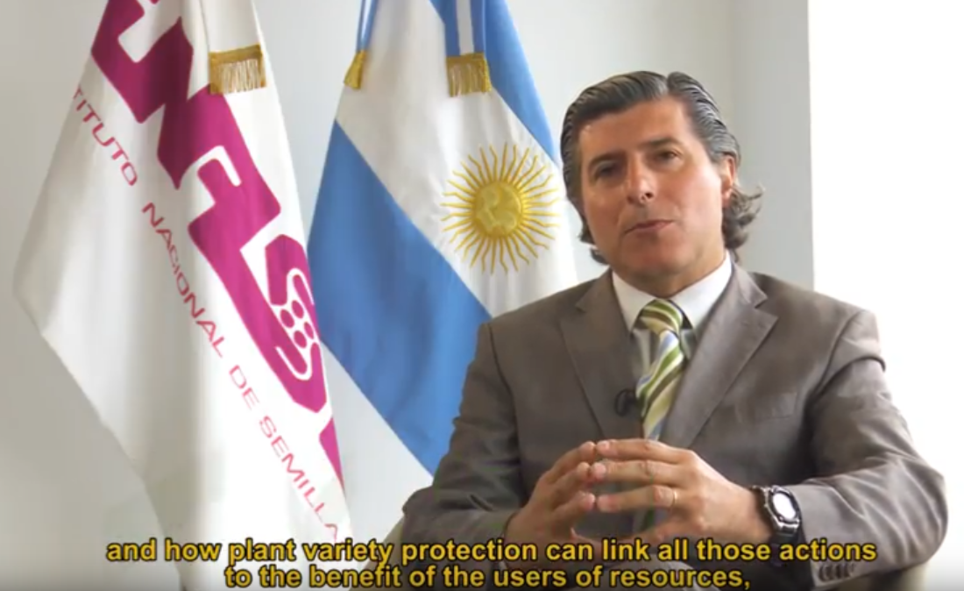
Using the UPOV System to benefit custodians
of native wild germplasm in Argentina
“The royalties derived from commercialization of the variety are shared between the breeder and the provinces that contributed the native plant genetic resource.”
“A large part of the profits, basically, 50 per cent, that are generated from the commercialization return to those provinces.”

Slide 44
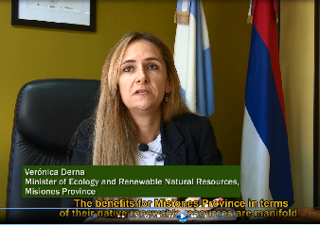
Using the UPOV System to benefit custodians
of native wild germplasm in Argentina
“the erosion/loss from their natural habitat is reduced and this is therefore our own contribution, working together with INTA, for the conservation of our native natural resources.”

