Slide 1
SEMINAR ON THE BENEFITS OF
PLANT VARIETY PROTECTION
Role of plant variety protection
in supporting
public-private partnerships
Peter Button
Vice Secretary-General, UPOV
September 20, 2018
Sofia, Bulgaria

Slide 2
Preview
Diversity in plant breeding to deliver maximum benefits for farmers
Making new varieties available to farmers
Examples

Slide 3
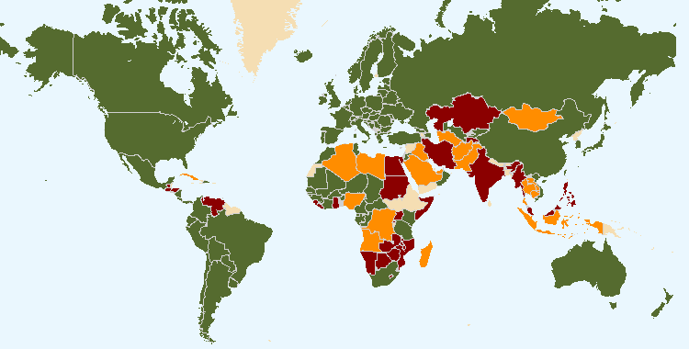
UPOV status
April 13, 2018
Bulgaria –
36th UPOV member April 24, 1998
(1991 Act)
European Union –
59th UPOV member July 29, 2005
(1991 Act)
The boundaries shown on this map do not imply the expression of any opinion whatsoever on the part of UPOV concerning the legal status of any country or territory
Members of UPOV (75) covering 94 States
Initiating States (16) and Organization (1)
States (26) and Organization (1) in contact with the UPOV Office

Slide 4

MISSION STATEMENT
“To provide and promote an effective system of plant variety protection, with the aim of encouraging the development of new varieties of plants, for the benefit of society”

Slide 5

UPOV MISSION STATEMENT
“To provide and promote an effective system of plant variety protection (PVP), […]”
Plant Breeder’s Right (PBR)

Slide 6
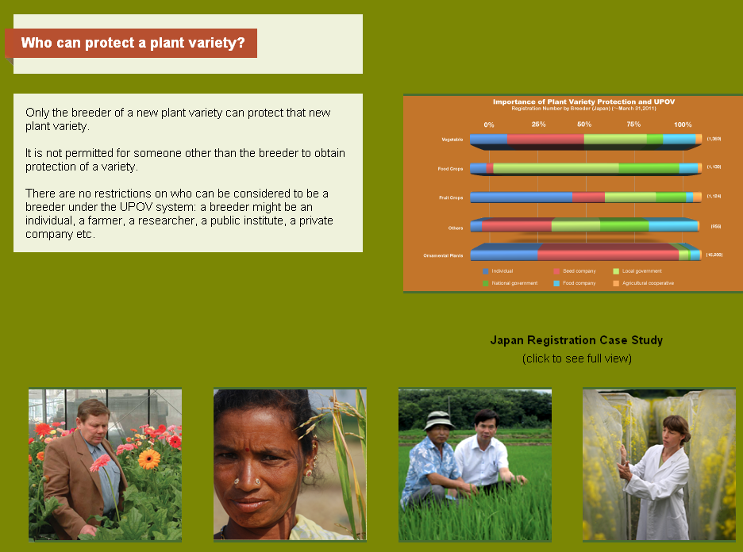
There are no restrictions on who can be considered to be a breeder under the UPOV system: a breeder might be an individual, a farmer, a researcher, a public institute, a private company etc.

Slide 7
CROPS
LARGE
PUBLIC
(GOVT.)
COMMUNITY
INTERNATIONAL
FOREIGN
NATIONAL
LOCAL
INDIVIDUAL
SMALL
TYPE OF VARIETY
PRIVATE

Slide 8
How can PVP be used to achieve maximum “public good”?
PUBLIC
(GOVT.)
PRIVATE

Slide 9
What are the practical challenges for technology transfer and commercialization?
or…
How to:
identify important variety performance characteristics for farmers
breed varieties with those characteristics
deliver good quality seed/propagating material in a timely way

Slide 10
What are the practical challenges for technology transfer and commercialization?
or…
How to:
identify important variety performance characteristics for farmers,
breed varieties with those characteristics
deliver good quality seed/propagating material in a timely way

Slide 11
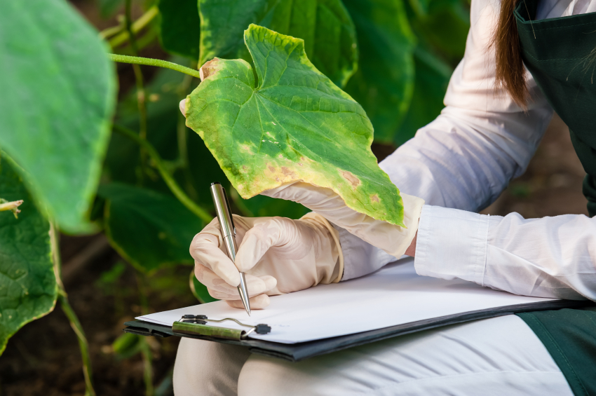

(Photo: iStockphoto.com/VladTeodor)
(Photo: iStockphoto.com/luoman)

Slide 12
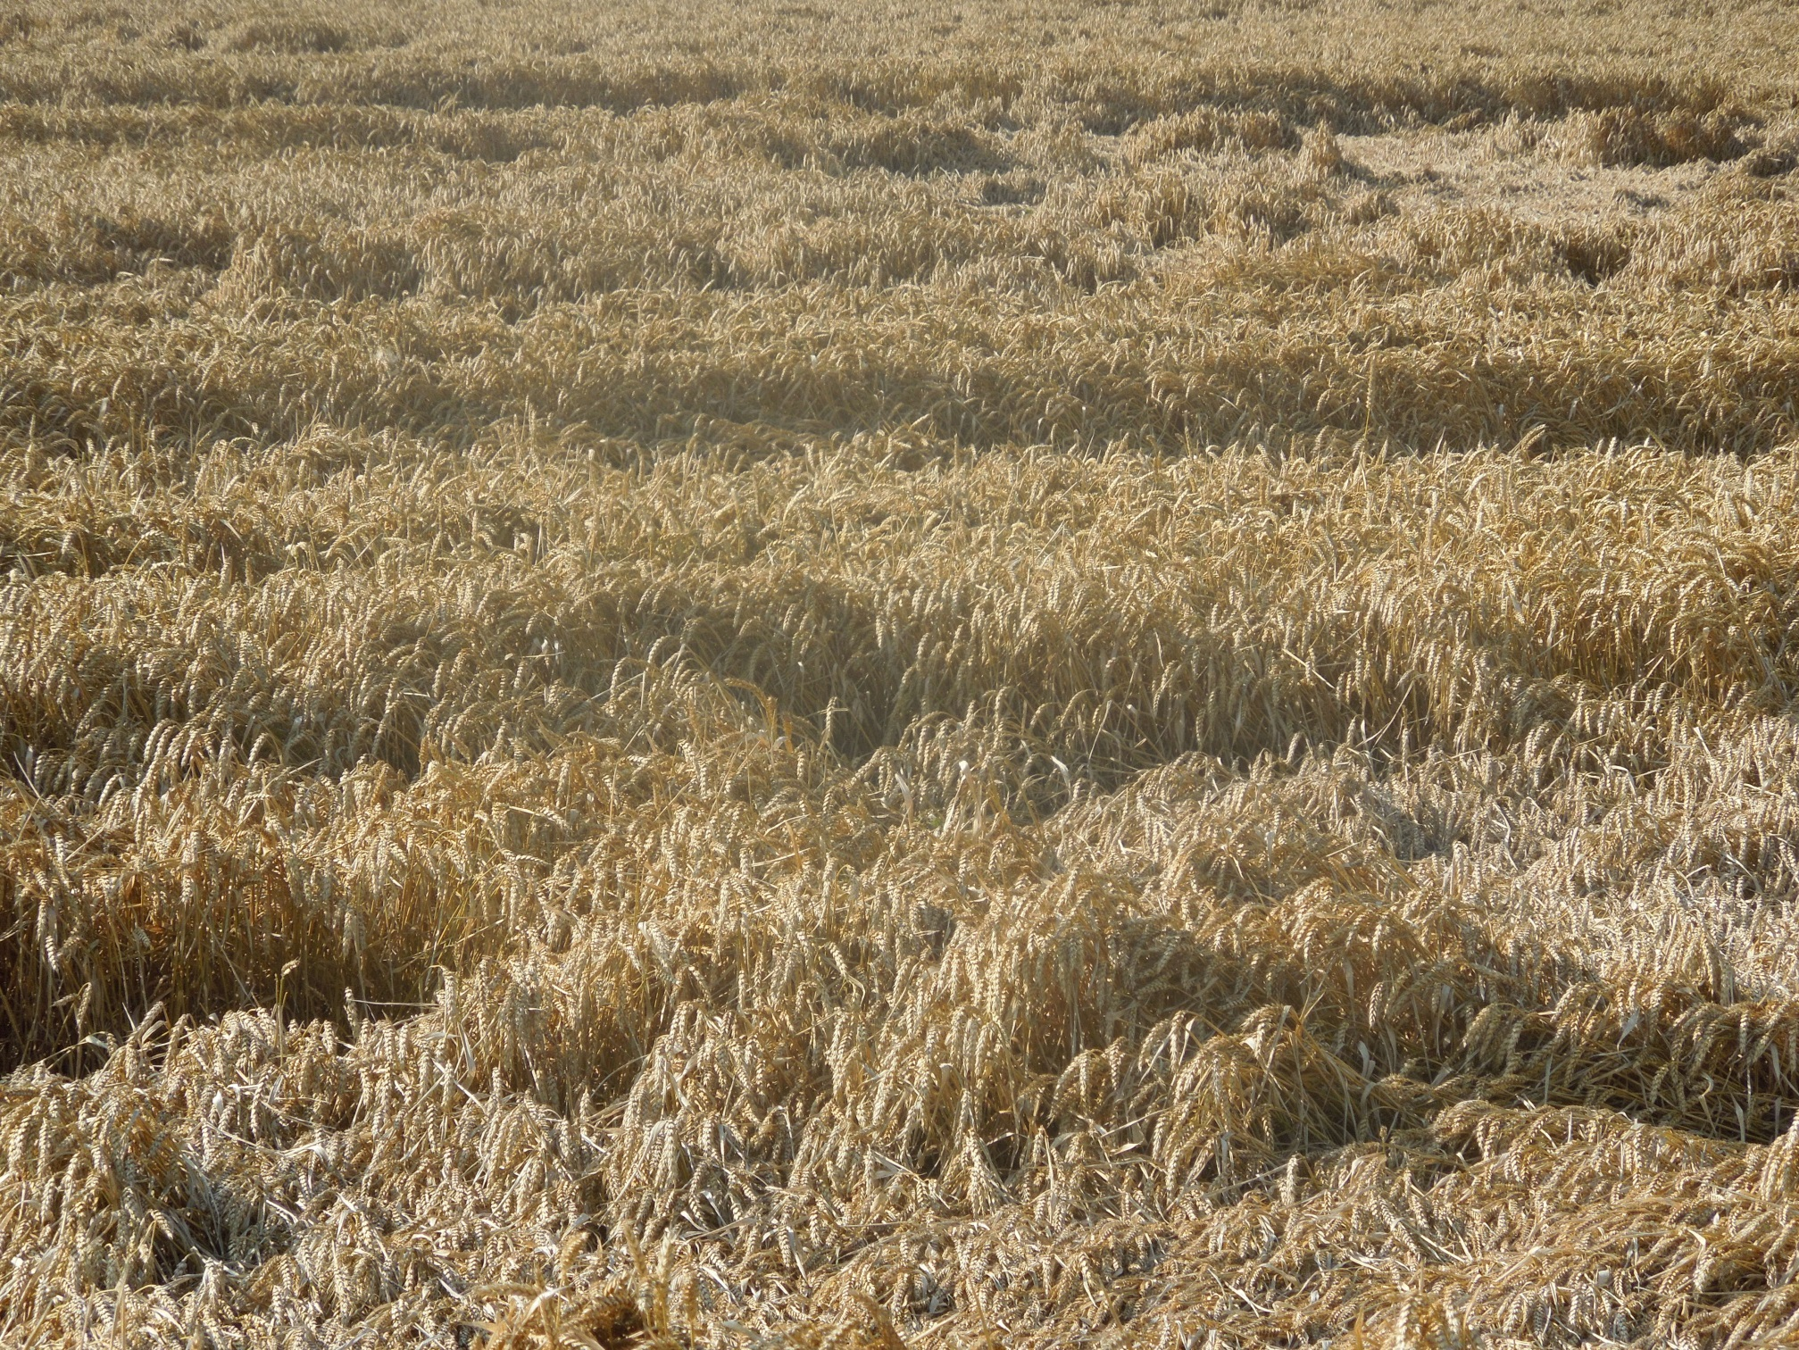

(Photo: BSPB)
(Illustration: iStockphoto.com/Cory Thoman)

Slide 13

(Photo: istockphoto/saiyood)

Slide 14
What are the practical challenges for technology transfer and commercialization?
or…
How to:
identify important variety performance characteristics for farmers,
breed varieties with those characteristics
deliver good quality seed/propagating material in a timely way

Slide 15
Preview
Diversity in plant breeding to deliver maximum benefits for farmers
Making new varieties available to farmers
Examples

Slide 16
Domestic
BREEDERS
$
NEW VARIETIES
$
FARMERS,
GROWERS
CONSUMERS

Slide 17
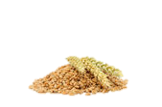









PRIVATE SECTOR
PUBLIC SECTOR
BREEDERS
International
Breeding (Institute)
National Breeding Institute
Large enterprises
(e.g. companies, cooperatives)
SME’s
Individuals
(e.g. farmers)
SEED PRODUCERS / PLANT PROPAGATORS
PBR LICENCES
SEED
INFORMATION
PRODUCTION
&
DISTRIBUTION
DISTRIBUTORS
SEED
SEED
SEED
SEED
SEED
SEED
SEED
FARMERS

Slide 18


Seed distribution system of new varieties
Change the mode on the agriculture production (Viet Nam (Minh 2017))
BEFORE PVP
AFTER PVP
License
Breeders
Breeders
Company
Royalty
No Professional distribution
system
Good professional distribution
system
Farmer
Farmer
Not professional
Seed quality control difficult
Good service for the farmer;
Better seed quality due to professional distribution

Slide 19
CROPS
LARGE
PUBLIC
(GOVT.)
COMMUNITY
INTERNATIONAL
FOREIGN
NATIONAL
LOCAL
INDIVIDUAL
SMALL
TYPE OF VARIETY
PRIVATE

Slide 20



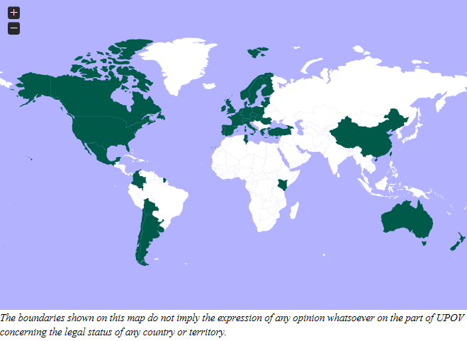
Online application tool to submit application data to participating PVP Offices in required format
Online PBR Application Tool
Easy access to PVP application forms, which can be displayed in
a range of languages
Much of the information provided in the Technical Questionnaire will be automatically translated
Relevant data can be re-used in subsequent applications
Different user roles can be specified (e.g. drafter, signatory, translator, agent)
Controlled access, secure and confidential

Slide 21
Preview
Diversity in plant breeding to deliver maximum benefits for farmers
Making new varieties available to farmers
Examples

Slide 22
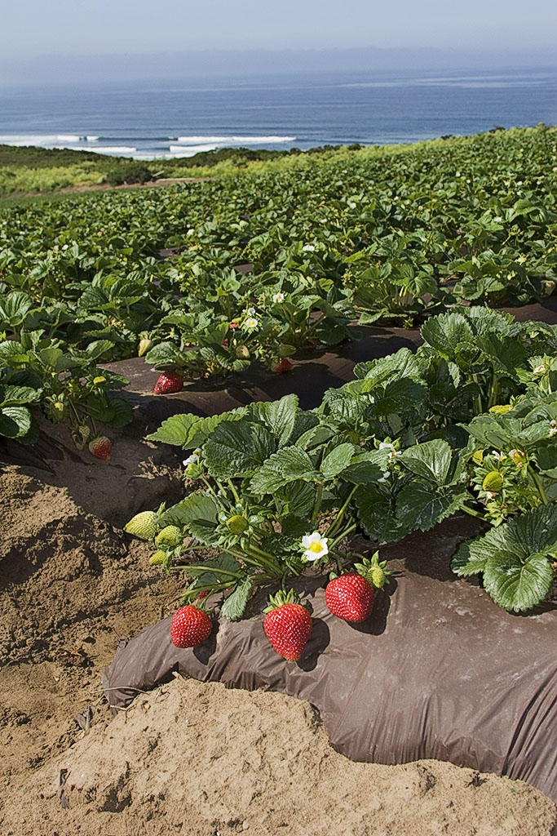
Michael D. Carriere, Ph.D.
Business Development and Intellectual Property Manager
UC Davis InnovationAccess
mdcarriere@ucdavis.edu

Slide 23
Plant variety licensing at UC Davis
Fair value for public asset
California advantage
  1st access to new varieties
  Preferential royalty rates
  Preferential (broader) sales territories
Transfer of know-how
Licensing - reactive to breeding outcomes

Slide 24
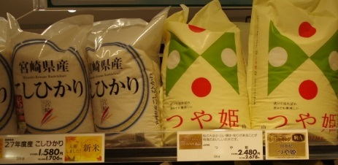
High Level Study Tour (Japan, July 2016)
Koshihikari
Tsuyahime

Slide 25

Rice variety “Tsuyahime”
High quality variety (good taste)
Yamagata prefectural government holds the plant breeder’s right
Royalty free for Yamagata farmers, royalty paid by other farmers
Location and agronomy (less fertilizer and pesticide) controlled to maintain quality (= high market price)
Increased farmers’ income

Slide 26


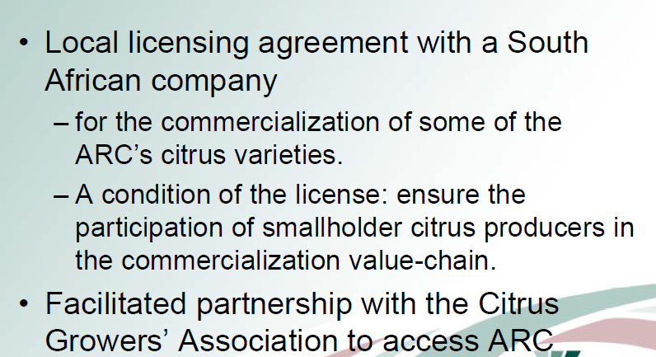
Symposium on the Benefits of Plant Variety Protection for Farmers and Growers
Vuyisile Phehane

Slide 27
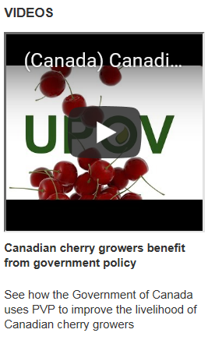
Nick Ibuki, Business Development Manager, Summerland Varieties Corp.
One of the biggest competitive challenges in the past, before plant breeders’ right was that new varieties would be developed here in British Columbia and they would go all over the world and they would actually be used to compete against our BC growers. So our growers would be competing against varieties that they paid to develop here […]
Sean Beirnes, General Manager, Summerland Varieties Corp.
When it comes to licencing, we provide Canadian growers and marketers with priority access.
By strategically allocating production and marketing territories, we ensure that Canadian growers and marketers, who represent a very small portion of the international fruit market, have an even playing field on which to compete. We would not be able to do this without plant breeders’ rights.

Slide 28
PUBLIC
(GOVT.)
PRIVATE

Slide 29
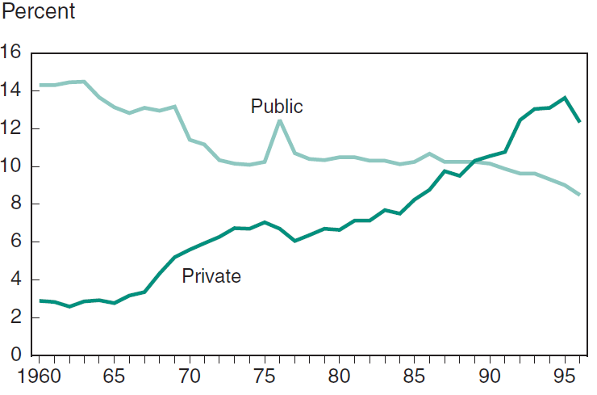
Plant Breeding as a share of total (US) agricultural R&D expenditures
Kitisri Sukhapinda, Office of Policy and External Affairs,
United States Patent And Trademark Office
Bangkok, Thailand: May 28-30, 2012

Slide 30
BREEDERS
NEW VARIETIES
INCOME
IMPROVED VARIETIES
FARMERS,
GROWERS
CONSUMERS

Slide 31
BREEDERS
NEW VARIETIES
INCOME
IMPROVED VARIETIES
FARMERS,
GROWERS
CONSUMERS

Slide 32
BREEDERS
NEW VARIETIES
INCOME
IMPROVED VARIETIES
FARMERS,
GROWERS
CONSUMERS

Slide 33

Experience Moving to UPOV’91?
Photo Courtesy of Grainswest Magazine: UPOV’91 January 23, 2014

Slide 34
Increased Investment
Bayer Crop Science new investments in wheat breeding
Limagrain/Canterra Seeds partnership – cereal breeding
Public/private/producer breeding consortium to fund Canadian Prairie Spring Red Wheat (CPSR)
New PBR applicants in the agriculture sector

Slide 35
Source: 2014 Mr. Kerrie Gleeson, Australian Grain Technologies Pty Ltd

