Slide 1
Challenges in enforcing plant variety rights
Antonio Villarroel
Secretary General - ANOVE
CPVO SEMINAR ON THE BENEFITS OF
PLANT VARIETY PROTECTION
Sofia, 20 September 2018

Slide 2
Organization of the Plant Breeding industry in Spain
anove
Spanish Plant Breeders Association
Representation, promotion and defence of common interests of plant breeders in Spain towards politics, authorities, economic agents, etc.
GESLIVE
Plant License Management
Management, protection and defence of intellectual property rights to plant varieties and materials

Slide 3
GESLIVE’ activities
GESLIVE was incorporated in 1996 as an independent organization by the main plant breeders operating in Spain.
Since 2014, GESLIVE is a subsidiary of ANOVE, which holds 100% of the capital stock
GESLIVE’ main role is management, protection and defence of PVRs:
  Legal assistance
  Licenses management
    3,400 licenses on 1,350 varieties in 2017
  Inspection activities
    1,300 inspections in 2017
  Enforcement
    54 lawsuits in 2017 (almost 600 since 1997!!)

Slide 4
Most common infringements of IP in the seeds and plants sector
Open pollinated varieties (cereals, forage crops) – “brown bags” and “fake” farm saved seeds
Hybrid vegetable seeds – theft of parental lines, vegetative propagation
Hybrid field crops seeds (Maize, Sunflower) – theft of parental lines, counterfeit seeds
Fruit and ornamental plants – vegetative propagation
Misuse of Trademarks and variety denomination
Offenders:
  Competitors
  Farmers & growers
  Nurseries & Plant-raisers
  Organized crime
In many cases, infringers = customers (key feature of infringements to PVRs!)
Fighting infringements is very hard to individual breeders

Slide 5
Consequences of infringements of IP and illegal seeds and plants practices
Compromise seeds and plants quality:
  grain harvested from hybrids is mis-represented and sold as genuine hybrid seed for sowing
  seed and plants are mislabelled with false variety names
  minimum seed quality standards (purity, germination, etc.) are not met
Phytosanitary risks derived of clandestine activities out of official controls
Farmers’ livelihoods are placed at risk
Unfair competition with professional seed companies and nurseries
Confidence in the seed sector is undermined
Continuing investment by breeders in developing and delivering better varieties is undermined
Reputation and economic prospects of agricultural regions can be ruined
Overall capacity of sustainable food production decreases
In some cases, it is connected with criminal activities such as tax evasion, fraud, corruption and even labour exploitation

Slide 6
Why infringements occurred?
Cultural and social factors (traditional practices, etc.)
Lack of awareness or appreciation to plant breeders work and rights
Recession, low income for farmers
Relatively easy to organize
Low risk: not in the main focus of the law enforcement
  Means no harm to the human health (Pharmaceuticals, foods)
  Not so big loss on tax revenue (tobacco, alcoholic beverages)
  Political misunderstandings (“poor farmers vs big multinationals”)
High profit

Slide 7
Enforcement of EU PVRs
EU Regulation nº 2100/94:
  Infringing acts in relation to the variety or to the variety denomination:
  Infringers may be sued by the holder to enjoin such infringement or to pay reasonable compensation or both:
    Injunctions
    Damages – even without a culpable infringement.
    Penalties
Regulation (EU) No 608/2013 of 12 June 2013 concerning customs enforcement of intellectual property rights
  Customs authorities may stop and even destroy goods suspected of infringing IP rights, including PVR
Directive 2004/48/EC on the enforcement of intellectual property rights
  harmonisation of
    civil law measures,
    procedures and
    remedies

Slide 8
Enforcement of EU PVRs
Enforcement Directive 2004/48/EC:
Article 8 (1) (c): Information on the origin and distribution networks of the goods which infringe an intellectual property right shall be provided by the infringer and/or any other person who: (c) was found to be providing on a commercial scale services used in infringing activities
Article 11: Member States shall also ensure that right holders are in a position to apply for an injunction against intermediaries whose services are used by a third party to infringe an intellectual property right,

Slide 9
Enforcement: main obstacles
Legislative shortcomings
Ignorance of applicable regulations and technical aspects (production and multiplication of plant material, variety identification, etc.) by authorities (Courts, public prosecutors, police, etc.)
Evidence collection:
  Traceability of legal origin?
Variety identification
  Phenotype vs genotype – Admissibility of DNA analysis by Courts?
“Farmer’s privilege”: transparency on farm saved seed

Slide 10
Regulatory offences
Seed market strongly regulated in EU (certification scheme)
Counterfeited seeds imply regulatory offences against EU seed production and market regulations.
Nevertheless…
  Opacity of administrative proceedings in some countries (i.e., right holder not acknowledged as party in the proceedings – no intervention)
  Lack of commitment by competent authorities in the prosecution of counterfeited seeds and plants
  No dissuasive fines (to deterring further infringements – TRIP’S):
    Example: € 600 on average in Spain!!
Notes:
rosecution

Slide 11
Effective enforcement tools
Sufficient information and access
Fast proceedings
Specialized Courts
Full compensation of costs
Effective border measures
Deterrent sanctions

Slide 12
Stakeholders to improve Enforcement
Government ministries, agencies and institutions (
  Central / national / federal
Provincial / state
Judicial system
PBR holders
Plant Breeders / Seed Industry Organizations

Slide 13
PVRs infringements in Spain
Infringements of plant breeders’ rights are widespread in Spain in some crops
Some examples:
  Cereals: 33 % certified seed
    The other 66 % comes from two sources:
      Genuine farm saved seed (estimated 33%)
      Brown bags – “fake FSS” (estimated 33%)
  Vegetables: 20% of tomato plants are illegally produce through vegetative reproduction (”stubs”)
  Fruits: More than 50% of fruits trees and berry plants come from non controlled sources in some areas

Slide 14
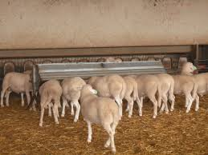
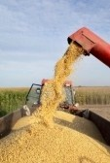
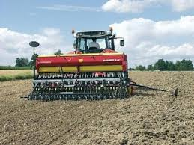
Differentiation between “Illegal Seed” and “harvested material” in Spain
Main defense arguments pleaded in case law:
  “Authentic” farm saved seed (farmers exception)
  Harvested material
No specific diligence obligations to the seller
Relevant indications or evidence of infringement (harvested material used as propagating material) in Spain’ case law:
  Division and identification of the material by varieties
  Presence of seed processing machinery
  Processing, cleaning and/or treating
  Purity and germination degrees
  Price (higher than commodity grains – lower than certified seed)
  Dates (coincidence with sowing season)
Plenty of sentences condemning seed sellers (most of them between 6 months to 1 year imprisonment)

Slide 15
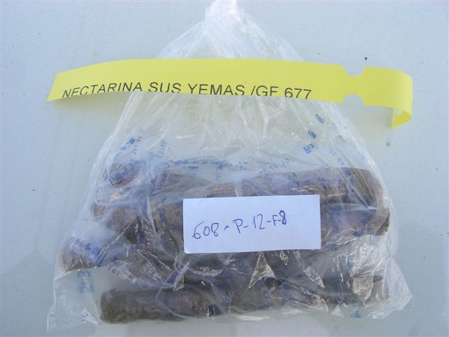
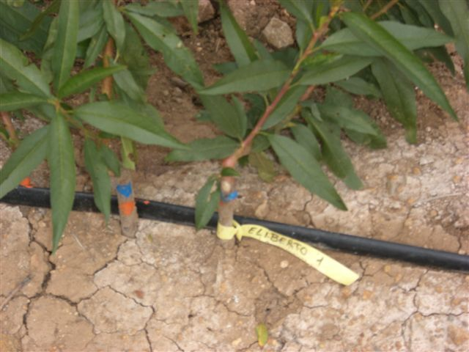
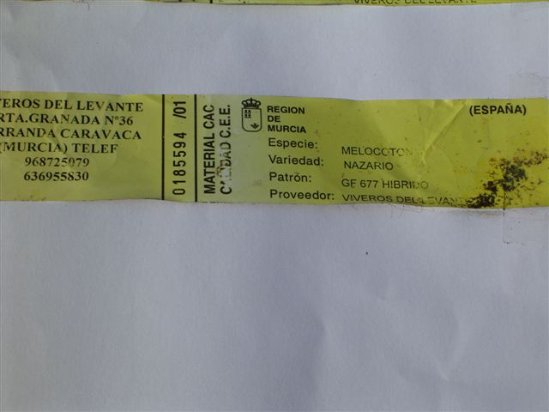
Examples of common infringements in the fruit sector
Illegal multiplication of protected varieties by plant nurseries
(often disguising the true variety denomination):

Slide 16
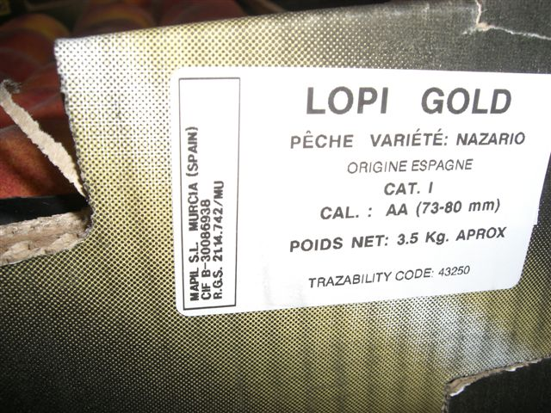
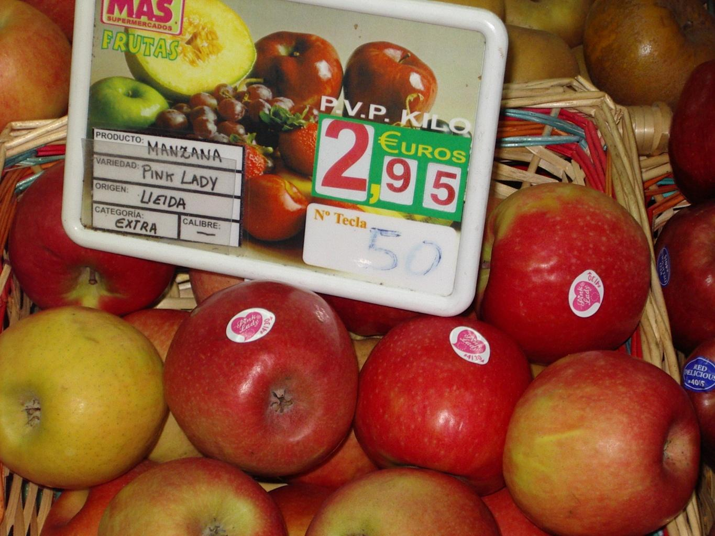
Examples of common infringements in the fruit sector
Marketing by retailers of PVP’ fruit produced from illegally reproduced plants (often disguising the true variety denomination with fantasy names, or using protected variety denominations for other varieties):

Slide 17
Spain’ regulation on PVR’s infringements
Civil liability :
  Termination of acts.
  Compensation for damages.
  Collection and destruction of all illegitimate material.
  Attribution to the breeder of material ownership.
  Publication of the judgment at the expense of the offender.
  Measures necessary to prevent a new infringement.
Administrative infraction: fine.
Criminal offense: prison sentence and fine.
Extension to the product of the harvest (fruit) and derived products.
Extension of responsibility to the different operators in the commercialization chain.

Slide 18
Spain’ regulation on PVR’s infringements
Article 274.4 Spanish Criminal Code:
It shall be punishable by penalties of 1 to 3 years' imprisonment whom, for agricultural or commercial purposes, without the consent of the holder of a plant variety certificate and with knowledge of its registration, produce or reproduce, condition with a view to production or reproduction, offers for sale, sells or markets in any other form, export or import, or possesses for any of the aforementioned purposes, plant propagating materials of a protected plant variety according to national or European Union legislation on the protection of plant varieties.
Any person who performs any of the acts described in the preceding paragraph by using, under the name of a protected plant variety, propagating materials of that does not belong to such variety, shall be punished with the same penalty

Slide 19
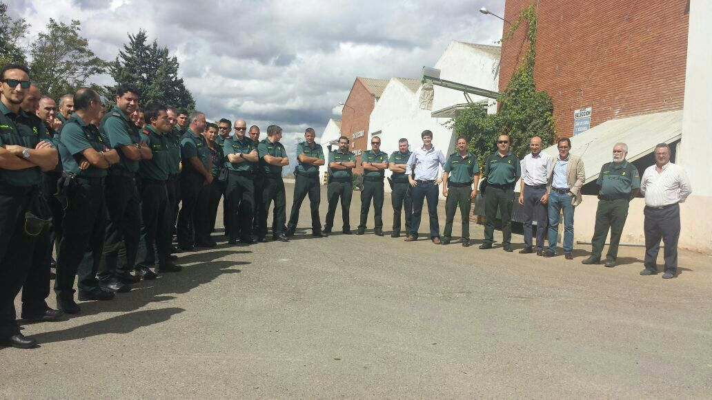
Examples of what is done by Plant Breeders Associations: Police training by Geslive

Slide 20
Examples of what is done by Plant Breeders Associations: Police training by Geslive
ZONE | DATES | PLACES | COMANDANCES INVOLVED | C.G.s TRAINED
ARAGÓN | 3 sep. | HUESCA | HUESCA | 6
 |  |  | ZARAGOZA | 9
 | 4 sep. | TERUEL | TERUEL | 14
CATALUÑA | 9 sep. | BARCELONA | BARCELONA | 14
 |  |  | GERONA | 3
 |  |  | LÉRIDA | 3
 |  |  | TARRAGONA | 4
MURCIA | 10 sep. | MURCIA | MURCIA | 11
CASTILLA Y LEÓN | 17 sep. | PALENCIA | BURGOS | 8
 |  |  | LEÓN | 8
 |  |  | PALENCIA | 13
 | 18 sep. | SEGOVIA | ÁVILA | 8
 |  |  | SEGOVIA | 15
 |  |  | SORIA | 8
 | 7 oct. | SALAMANCA | SALAMANCA | 16
 |  |  | VALLADOLID | 4
 |  |  | ZAMORA | 10
ANDALUCÍA | 23 sep. | CORDOBA | CÓRDOBA | 18
 |  |  | JAÉN | 15
 | 24 sep. | SEVILLA | ALGECIRAS | 4
 |  |  | CÁDIZ | 5
 |  |  | HUELVA | 12
 |  |  | SEVILLA | 19
 | 25 sep. | MALAGA | MÁLAGA | 12
 |  |  | GRANADA | 16
CASTILLA-LA MANCHA | 29 sep. | CIUDAD REAL | CIUDAD REAL | 20
 |  |  | TOLEDO | 8
 | 30 sep. | CUENCA | ALBACETE | 18
 |  |  | CUENCA | 14
 |  |  | GUADALAJARA | 3
LA RIOJA | 1 oct. | LA RIOJA | LA RIOJA | 15
EXTREMADURA | 14 oct. | MÉRIDA | BADAJOZ | 23
 |  |  | CÁCERES | 10
TOTAL: 366 Civil Guards from 33 Comandances

Slide 21
Examples: Legal proceedings in Spain
LEGAL PROCEEDINGS
 | 1999 | 2000 | 2001 | 2002 | 2003 | 2004 | 2005 | 2006 | 2007 | 2008 | 2009 | 2010 | 2011 | 2012 | 2013 | 2014 | 2015 | 2016 | 2017 | Total
Regulatory Offences | 11 | 17 | 34 | 40 | 31 | 8 | 7 | 1 | 3 | 3 | 9 | 25 | 19 | 52 | 176 | 19 | 3 | 4 | 5 | 467
Proceedings at Court | 22 | 28 | 12 | 6 | 29 | 39 | 26 | 23 | 41 | 26 | 13 | 6 | 14 | 17 | 42 | 70 | 60 | 56 | 54 | 584

Slide 22
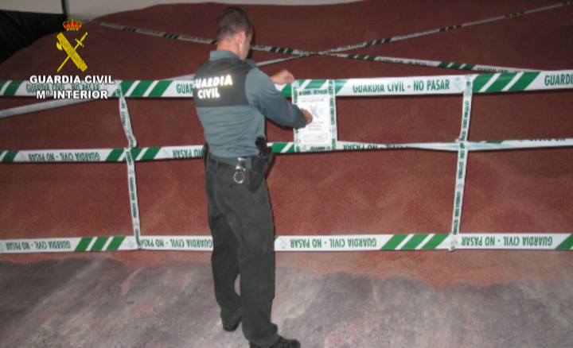
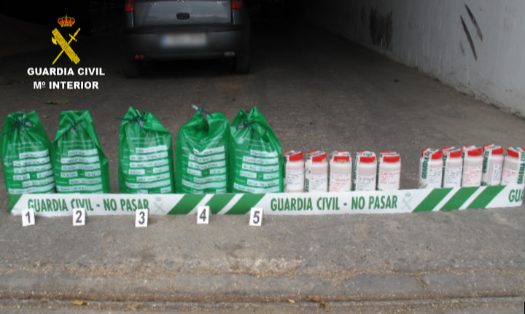
Examples of what is done by Plant Breeders Associations: Enforcement by Geslive

Slide 23
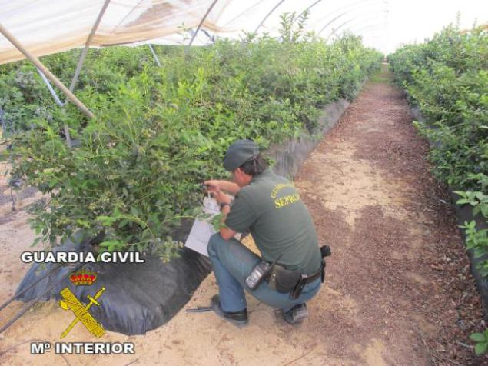
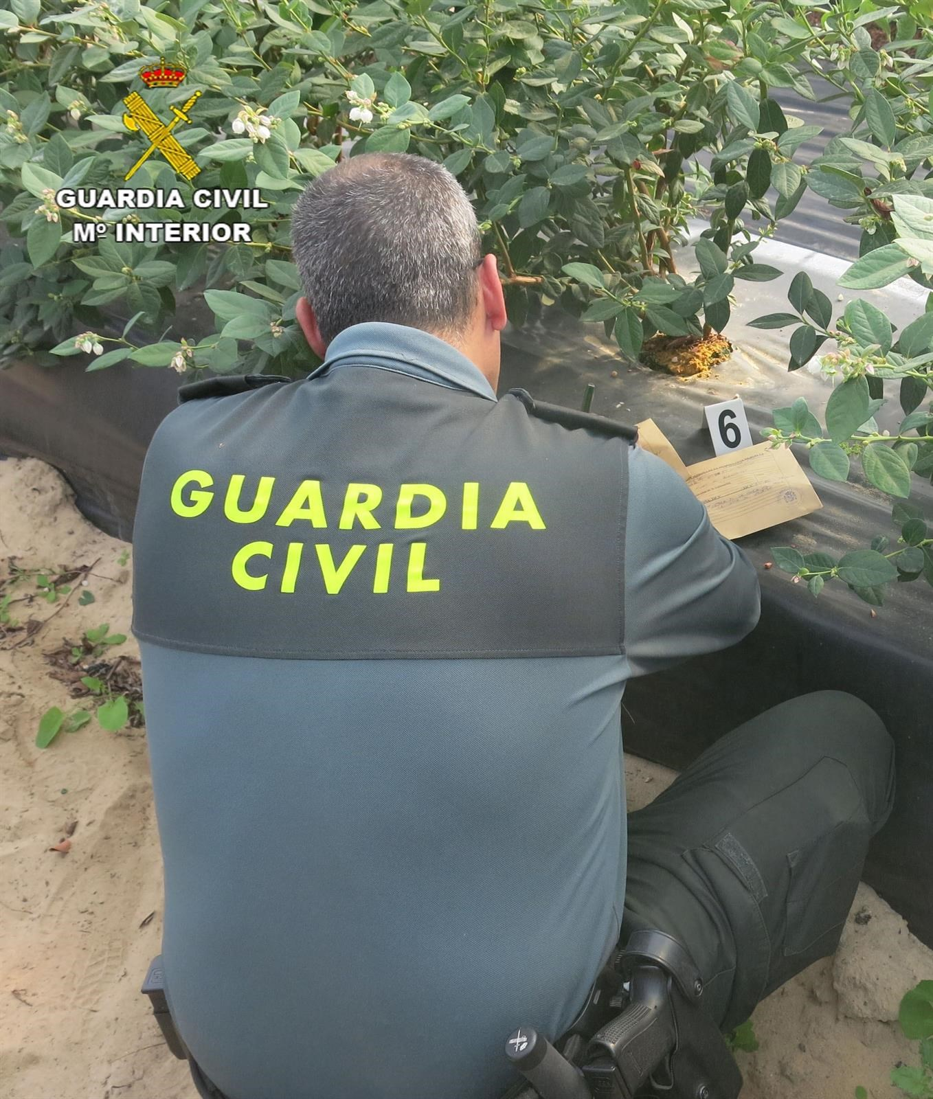
Examples of what is done by Plant Breeders Associations: Enforcement by Geslive

Slide 24
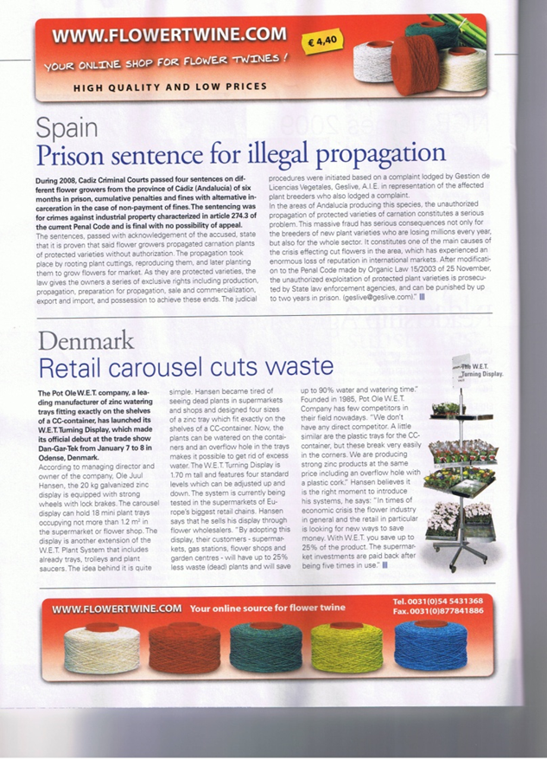
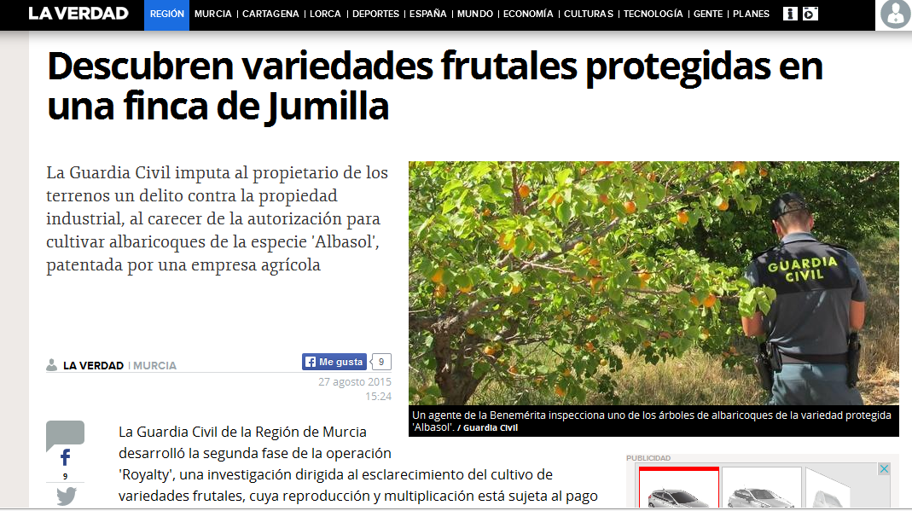
Examples of what is done by Plant Breeders Associations: Enforcement by Geslive

Slide 25
Examples of what is done by Plant Breeders Associations: Next steps…
First workshop to Judges in collaboration with EU IP Office and the University of Alicante:
  Great success: more than 50 judges registered…
  Next workshops will follow yearly
Building alliances with stakeholders:
  New FSS scheme agreed with farmers unions and cooperatives
  Collaboration agreements with farmers unions, growers and exporters associations, nurseries, main universities
Communication, communication, communication…
  Systematic open field days to politicians, authorities, media, etc.
  Tour with main media journalists to Fruit Logistica, etc.

Slide 26
Conclusions
Illegal seed practices and PVRs infringements are widespread in many countries, and constitute a very serious threat to the seed industry
It is not a simple issue, but a complex problem involving historical, cultural, social and economic factors
Simplification of the problem (i.e., nurseries or farmers = criminals in some “hot” areas, or “PVRs” = “multinationals against poor farmers”) will not help to understand and solve it
Seed sector, farmers and officials should fight together
Associations should play a major role in enhancing the plant breeders environment and activities
Communication and education are essential tools to improve social perception and appreciation of plant breeders work and, thus, wide respect of PBRs

Slide 27
Thank you for your attention!

