Slide 1
THE EU PLANT VARIETY SYSTEM
Francesco MATTINA, Vice-President
Community Plant Variety Office
SEMINAR ON THE BENEFITS OF PLANT VARIETY PROTECTION
20 September 2018 – Sofia, Bulgaria

Slide 2
OUTLINE
  I. Introduction to the European Union Plant Variety System
  II. The CPVO
  III. Community Plant Variety Rights
  IV. Application Procedure
  V. Proceedings before the Office and appeals
  VI. Enforcement
  VII. Statistics
  VIII. Final Remarks

Slide 3

  I. Introduction to the European Union Plant Variety System
1. Historical Background
2. Coexistence of the CPVR system
3. Legal Basis

Slide 4
Historial Background
Sui generis system for the industrial property protection of plant varieties (Art. 1 BR)
The intellectual property rights granted under this system are valid throughout the territory of the 28 Member States of the EU, encompassing over 450 million consumers
This system was established by a Council Regulation in 1994, which is modelled on the International Convention for the Protection of New Varieties of Plants of 1991 (1991 UPOV Act)
l
The EU became party to UPOV as inter-governmental organisation in 2005
ñ

Slide 5
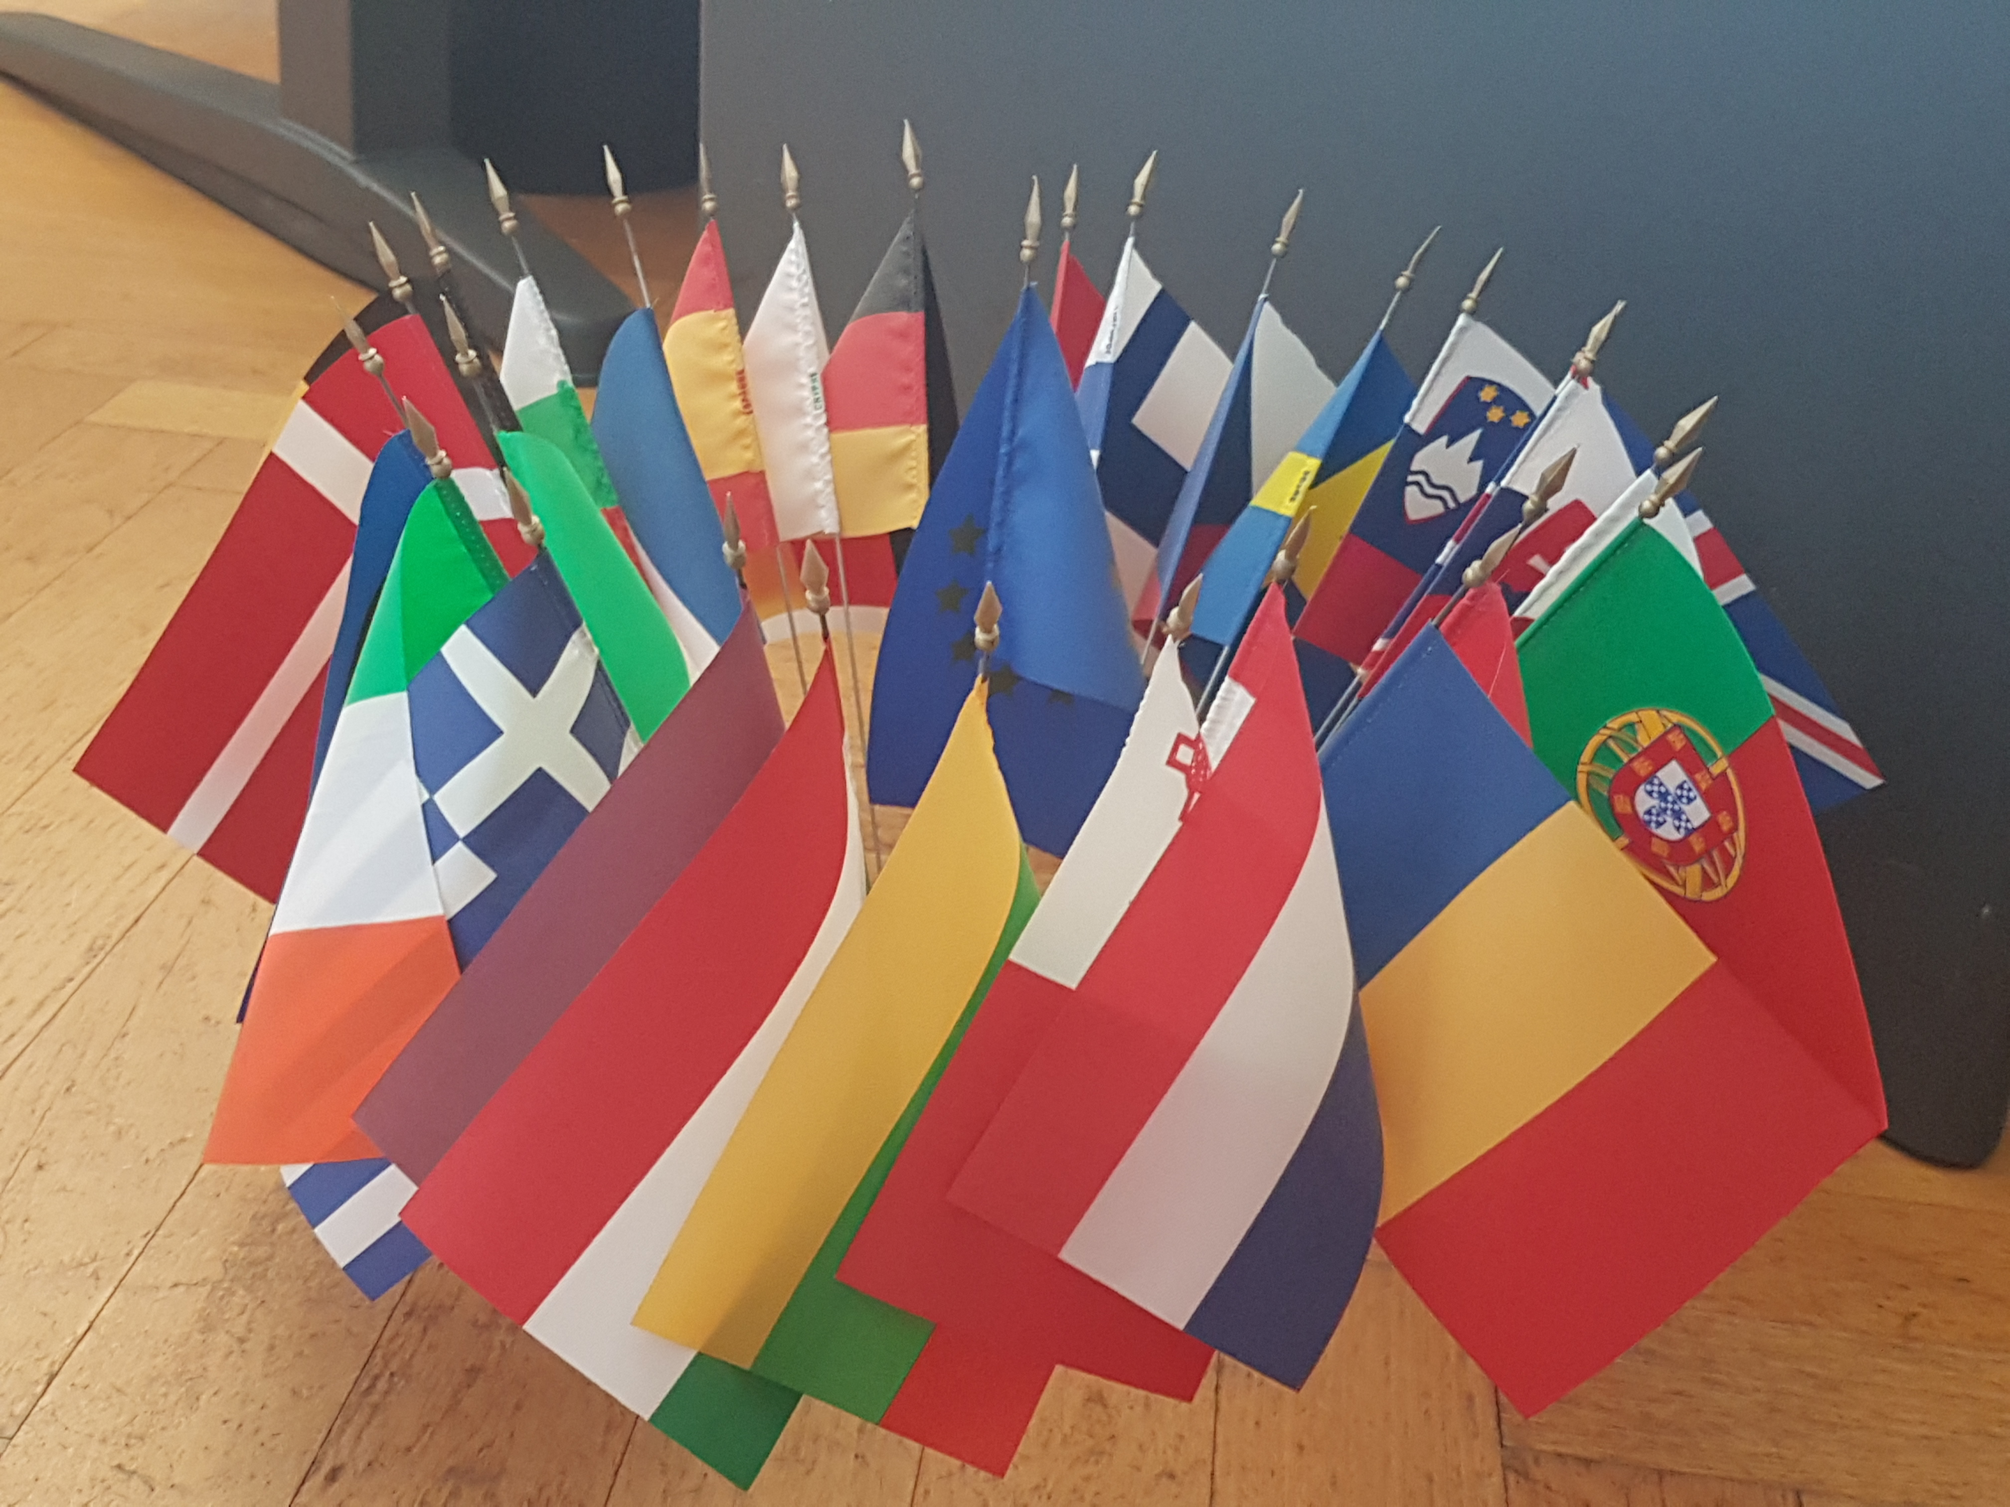

Coexistence of the CPVR system
The CPVR-system co-exists with the national systems
Applicant’s choice:
National* OR EU route (Art. 3 BR)
* 24 EU Member States are members to UPOV and have their own Plant Variety Rights’ system
(all EU MS with the exception of Cyprus, Greece, Malta and Luxembourg)

Slide 6

Legal Basis
    Basic Regulation (BR):
    Implementing Regulations (IRS):
  3 Commission Regulations relating to:
Council Regulation (EC) No 2100/94 on Community plant variety rights
Regulation No. 874/2009
Proceedings before the CPVO
Regulation No. 1238/95
Fees payable to the CPVO
Regulation No. 1768/95
The agricultural exemption

Slide 7

OUTLINE
  I. Introduction to the European Union Plant Variety System
  II. The CPVO
  III. Community Plant Variety Protection
  IV. Application Procedure
  V. Proceedings before the Office and appeals
  VI. Enforcement
  VII. Statistics
  VIII. Final Remarks

Slide 8
II. The CPVO
1. Description
2. Mission Statement
3. Institutional Framework
4. Organisational Chart
5. Administrative Council
6. Funding

Slide 9

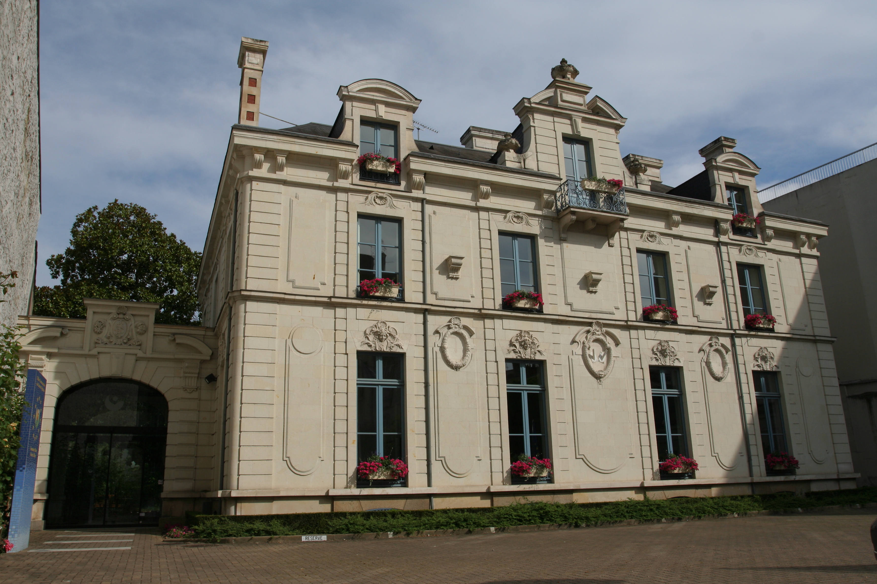
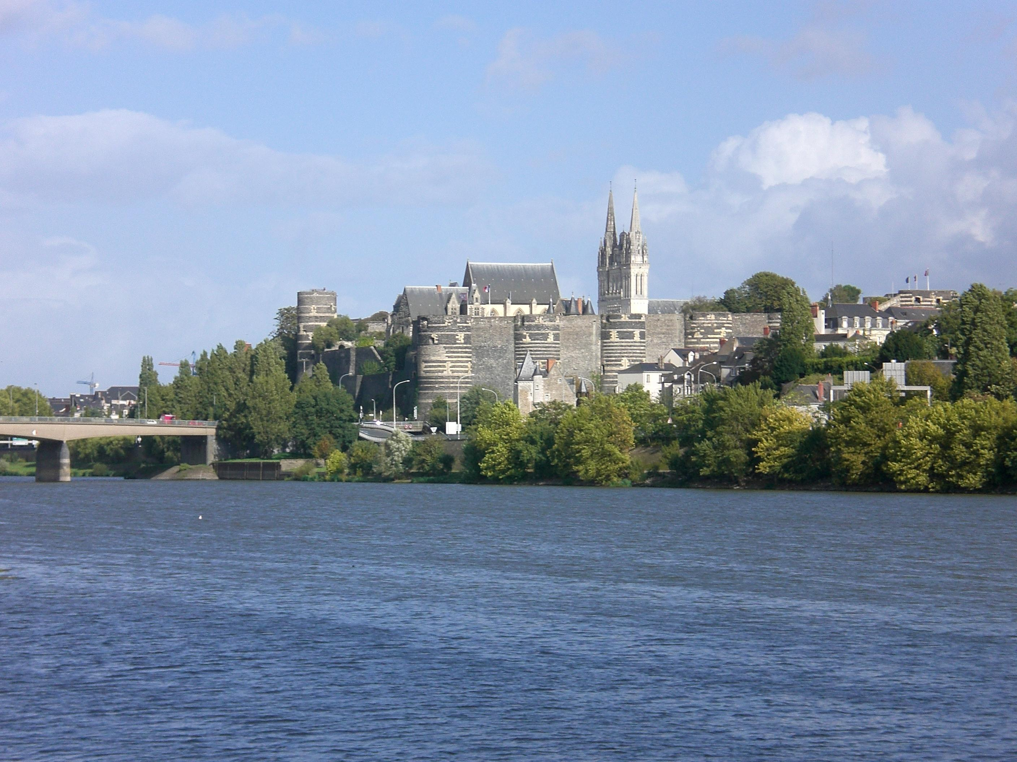
Description
The EU Plant Variety system is run by the Community Plant Variety Office (CPVO):
Official Agency of the EU
Based in Angers (France)
Operational since 1995
Independent legal status
Fully self-financed
President and Vice-President (appointed by the Council)

Slide 10
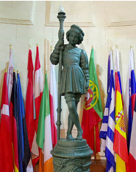
Mission statement
‘To deliver and promote an efficient Intellectual Property Rights system that supports the creation of new plant varieties for the benefit of Society’.

Slide 11
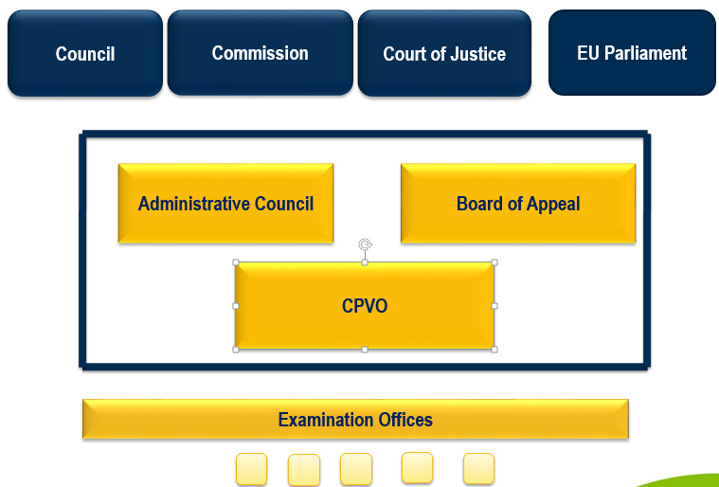

Institutional Framework

Slide 12
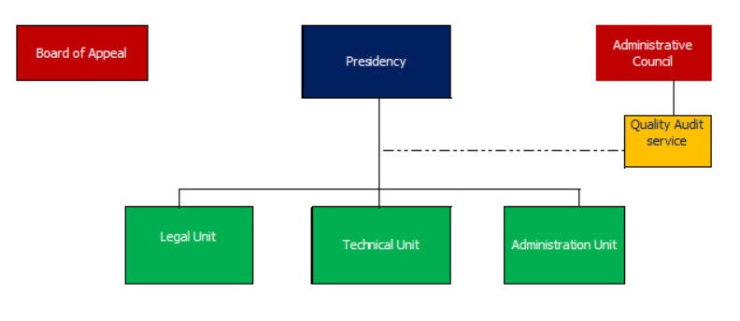
Organisational Chart

Slide 13

Administrative Council
  The Administrative Council (AC) is made up of representatives of the EU Member States, a representative of the European Commission and Observers
  The Administrative Council is responsible for:
    Monitoring the CPVO
    Approval of the Budget
    Approval of the Technical Protocols
    Entrustment of Examination Offices

Slide 14

Funding
Under the terms of the basic Regulation the CPVO is self-financing:
  It must administer the system without financial support from the general European Union budget
  The CPVO receives revenue from fees
  Due to the number of applications received and rights granted, the Office has been able to meet the requirement of financial self-sufficiency

Slide 15
OUTLINE
  I. Introduction to the European Union Plant Variety System
  II. The CPVO
  III. Community Plant Variety Rights
  IV. Application Procedure
  V. Proceedings before the Office and appeals
  VI. Enforcement
  VII. Statistics
  VIII. Final Remarks

Slide 16
III. Community Plant Variety Rights
1. Object of protection
2. Uniform effect
3. Duration
4. Scope of the rights
5. Exceptions to the protection

Slide 17
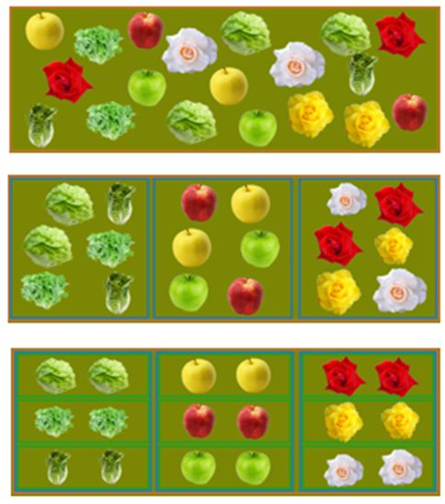
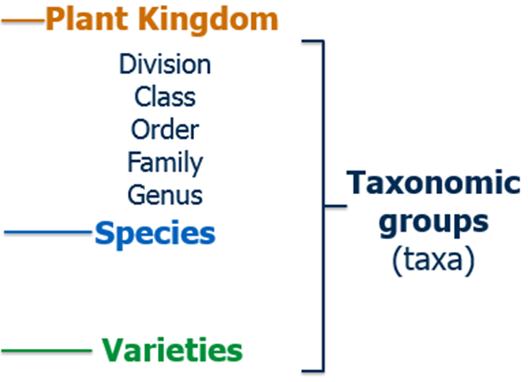
Object of protection
  Varieties of all botanical genera and species may be protected, including, inter alia, hybrids between genera or species [Art. 5(1) BR].
  The Office has received applications for more than 1900 species.
  What is a variety? ‘A plant grouping within a single botanical taxon of the lowest known rank’ [Art. 5(2) BR]

Slide 18


Uniform Effect of the Protection
Community plant variety rights (CPVRs) shall have uniform effect within the EU territory and may only be granted, transferred or terminated within such territory on a uniform basis (Art. 2 BR)
Duration of the Protection
The duration of the protection of plant varieties is of (Art. 19 BR):
Provisional Protection: it covers the period between publication of the application for a CPVR and the grant thereof (Art. 95 BR)

Slide 19

Scope of the Rights (Acts)
  The holder is entitled to carry out the following acts:
For the abovementioned acts, the authorisation of the holder is required [Art. 13(2) BR]:
The holder may establish conditions and limitations typically through contract
a) Production or reproduction (multiplication)
b) Conditioning for the purpose of propagation
c) Offering for sale
d) Selling or other marketing
e) & f) Exporting from/Importing to the European Union
g) Stocking for any of the above mentioned purposes

Slide 20


Scope of the Rights (Material)
The material scope of CPVRS includes [Art. 13(2) BR]:
      Also referred to as Propagating material
      Entire plants or part of plants (capable of producing entire plants)
      E.g.: grafts, cuttings, bulbs, layers, rhizomes, seeds
      Refers to all products of the harvest
      E.g.: fruit, vegetables, mushrooms, flowers, cereals, fodder, fibres
Variety constituents
Harvested material

Slide 21

Exceptions to the protection
  The main exceptions to CPVRS – restricting the breeder’s scope of rights – are:
  ,
  The limitations of the effects of CPVRS as listed in Art. 15 BR:
    Acts done privately for non-commercial purposes
    Acts done for experimental purposes
    Acts done for the purpose of breeding, or discovering and developing new varieties (the breeder’s exemption)
  The agricultural exemption (Farm-saved seed) (Art. 14 BR):
    Covering varieties belonging to a limited list of 21 agricultural crops in well-defined circumstances and classified into four categories:
  a) Fodder plants b) Cereals c) Potatoes d) Oil and fibre plants

Slide 22
OUTLINE
  I. Introduction to the European Union Plant Variety System
  II. The CPVO
  III. Community Plant Variety Rights
  IV. Application Procedure
  V. Proceedings before the Office and appeals
  VI. Enforcement
  VII. Statistics
  VIII. Final Remarks

Slide 23
IV. Application Procedure
1. Filing of the application
2. Examination of the application: Formal, Substantive and Technical Examination
3. CPVR Grant Requirements
4. Technical Examinations
5. Grant of the CPVR
6. Fees

Slide 24

Filing of the application
The system is open to any natural or legal person (Art. 12 BR)
  Applicants outside the EU must appoint a procedural representative (Art. 82 BR)
  If the applicant is not the breeder of the variety, a deed of assignment must be enclosed attesting to the transfer of rights (Art. 11 BR)
The CPVR application shall be filed (Art. 49 BR):
The application date is the date on which a valid application was received (Art. 51 BR)
- at the CPVO directly; OR - at one of the sub-offices or national agencies, established or entrusted

Slide 25


Examination of the application (I)
Examinations carried out by the CPVO:
Formal examination
Examinations carried out by Examination Offices:
Technical examination: DUS Testing
Substantive examination: Entitlement, Novelty, Variety Denomination

Slide 26




Examination of the application (II)
Formal Examination [Article 53(1) BR]The Office examines whether:
The application has effectively been filed (as per Art. 49 BR)
The application complies with the conditions laid down in Art. 50 BR (e.g.: request for the grant)
The fees have been paid within the due time limit (as per Art. 83 BR)
Substantive Examination [Article 54(1) BR]The Office examines whether:
The variety can be defined as such pursuant Art. 5 BR
The variety is new (Art. 10 BR)
The applicant is entitled to file an application (Art. 12 BR) & to the CPVR (Art. 11 BR)
The proposed Variety Denomination is suitable (Art. 63 BR)
Technical Examination [Article 55(1) BR]
Whether the variety is Distinct, Uniform & Stable
Filing of the application
Formal, Substantive & Technical Examination
Decision of grant or refusal

Slide 27

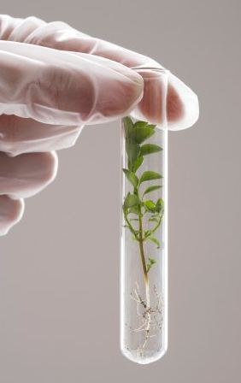
CPVR Grant Requirements
The Plant Variety must comply with the following requirements
(Art. 6 BR):
THE DUS CRITERIA
D – Distinctivity
U – Uniformity
S – Stability
NOVELTY
VARIETY
DENOMINATION

Slide 28
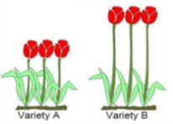

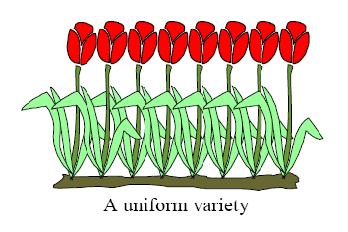


DUS Criteria
The candidate variety should be:
Distinct from already existing varieties of common knowledge at the time of the application filing (Art. 7 BR)
Uniform in the expression of its relevant characteristics (Art. 8 BR)
Stable in its characteristics, that should remain unchanged after repeated propagation (Art. 9 BR)

Slide 29



Novelty
The candidate variety must not have been sold/disposed of to others by or with the breeder’s consent within the EU for purposes of exploitation of the variety [Art. 10(1) BR]:
(a) earlier than 1 year before the application date, within the EU
(b) earlier than 4 years or, in the case of trees or of vines, earlier than 6 years before the application date, outside the EU

Slide 30




Variety Denomination
The applicant proposes the Variety Denomination [Art. 50(3) BR]
If suitable, the Office approves it [Art. 54(1) BR]
A variety is considered suitable if there are no impediments (Art. 63 BR)
Variety Denominations must not be confused with Trade marks!

Slide 31

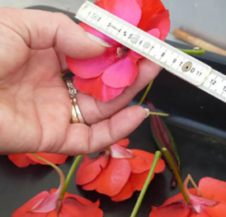
Technical Examinations
The CPVO has not created its own technical infrastructure
Technical examinations are carried out by the Examination Offices (EOs) entrusted by the Administrative Council
The attribution of varieties for DUS testing to EOS is done according to defined criteria:
  Wish of the breeder (usual criteria)
  Origin of the applicant
  Geographical origin of the variety
  Experience of the EO

Slide 32
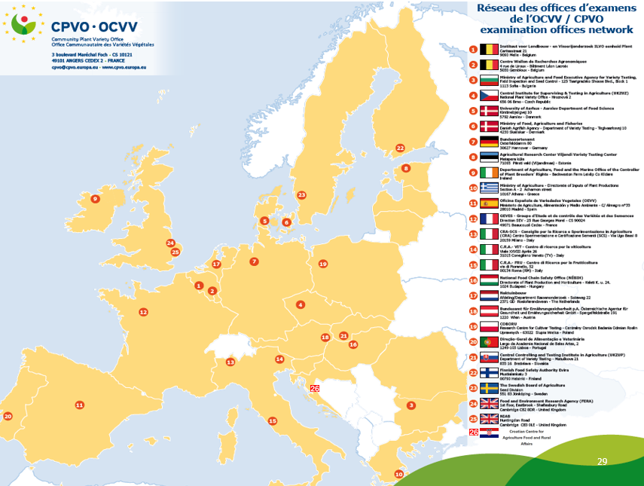

Slide 33

Technical Protocols
Technical examinations are generally carried out according to the CPVO technical protocols [Art. 56(2) BR] In default of these, UPOV guidelines shall serve as reference [Art. 22(3) PR]
The CPVO technical protocols contain a compulsory list of characteristics to be met by the varieties
The CPVO protocols are:
    Based on the relevant UPOV guidelines
    Elaborated together with national crop experts
    Formally adopted by the CPVO’s Administrative Council

Slide 34

Technical reports
Technical report:
  Issued after the technical examination
  It can be positive or negative
  If positive, it will include a description of the variety
  The applicant has 2 months to send its comments on the report
Take-over of technical reports: if a technical examination is carried out by an entrusted EO on a variety benefiting from national PVRs or entered for EU national listing, the CPVO may consider their report as basis for a decision
Exchange of technical reports: the CPVO can submit reports to any other authority on request

Slide 35
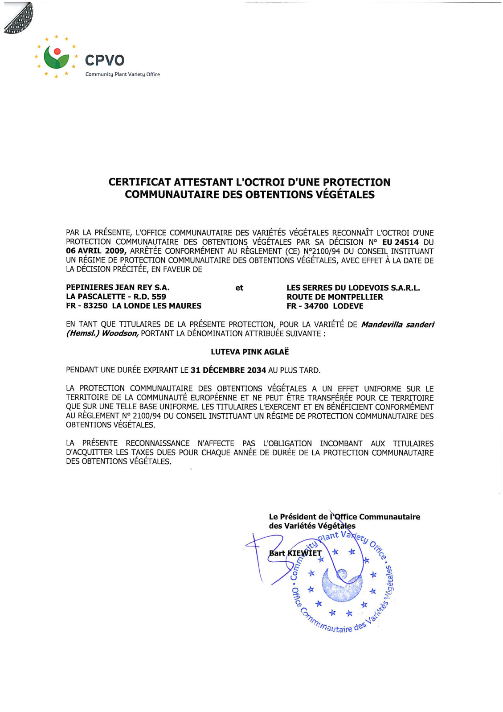

Grant of the CPVR
If the Office considers that the examination findings are sufficient and there are no impediments, it shall grant the CPVR and the decision shall include an official description of the variety (Art. 62 BR)
If a CPVR requirement is not fulfilled, the application is rejected (Art. 61 BR)

Slide 36

Fees
Application fee:
  paper – 650 EUR
  online – 450 EUR
  Examination fee: 1430 - 3210 EUR
  per year/cycle of DUS test
  Take over fee: 320 EUR
  Annual fee: 330 EUR

Slide 37
OUTLINE
  I. Introduction to the European Union Plant Variety System
  II. The CPVO
  III. Community Plant Variety Rights
  IV. Application Procedure
  V. Proceedings before the Office and appeals
  VI. Enforcement
  VII. Statistics
  VIII. Final Remarks

Slide 38
V. Proceedings before the Office and appeals
1. Objection
2. Nullity
3. Cancellation
4. Appeals

Slide 39
Objection
Any person may lodge with the CPVO a written objection to the grant of a CPVR (Art. 59 BR)
Objectors shall be party to the CPVR grant proceedings
Objections may be based only on the grounds of:
  Conditions laid down in Articles 7 to 11 BR
    The objection may be lodged at any time after the application and prior to a grant/refusal decision
  An impediment to a proposed variety denomination
    The objection shall be lodged within 3 months of the publication of the proposed variety denomination
Decisions on objections are taken by the ad hoc Committee of 3 members

Slide 40
  Nullity
  Nullity actions may be initiated by the Office on its own motion or upon request (Art. 53a PR)
  The Office shall declare the CPVR null and void if (Art. 20 BR):
  the conditions laid down in Articles 7 (distinctness) or 10 BR (novelty) were not complied with at the time of the CPVR
  the conditions laid down in Articles 8 (uniformity) and 9 BR (stability) were not complied with at the time of grant
  the right has been granted to a person who is not entitled to it
  If the nullity action succeeds, the CPVR shall be deemed not to have had effects as from the outset (ex tunc)

Slide 41

Cancellation
  Cancellation actions may be initiated by the Office on its own motion or upon request (Art. 53a PR)
  The Office shall cancel the CPVR if the variety is no longer uniform or stable [Art. 21(1) BR]
  The Office may also cancel the CPVR if the holder [Art. 21(2) BR]:
  does not provide the information to verify that the variety remains ‘unaltered’
  does not propose a suitable variety denomination
  fails to pay fees to maintain the CPVR in force
  no longer satisfies the conditions of entitlement
  The effects of a cancellation are ‘in futurum’ (ex nunc)

Slide 42

Appeals
The Board of Appeal is a quasi-judicial body responsible for deciding on appeals
Any natural or legal person may appeal against a decision addressed to that person or against a decision of direct and individual concern (Art. 68 BR)
The appeal must be lodged within 2 months (and the grounds of appeal within 4 months) from the date of publication of the concerned decision (Art. 69 BR)
An appeal fee of 1500 EUR needs to be paid
The appeal has a suspensory effect on the contested decision [Art. 67(2) BR]
Interlocutory revision: the CPVO body which prepared the decision may rectify it (Art. 70 BR)

Slide 43
Decisions subject to appeal
Nullity / cancellation of a CPVR (Arts. 20 and 21 BR)
Compulsory exploitation rights (Arts. 29 and 100 BR)
Objections to the grant of a CPVR (Art. 59 BR)
Refusal of an application/ Grant of a CPVR (Arts. 61 and 62 BR)
Approval/amendment of variety denominations (Arts. 63 and 66 BR)
Fees (Art. 83 BR)
Apportionment of costs (Art. 85 BR)
Establishment of the Registers/ Public inspection (Arts. 87 and 88 BR)

Slide 44

Actions against BOA decisions
Actions may be brought before the General Court against BOA Appeal decisions within 2 months from the decision (Art. 73 BR)
The actions shall be based on the following grounds:
  Lack of competence;
  Infringement of an essential procedural requirement;
  Infringement of the Treaty, the BR or the rules relating to their application;
  Misuse of power.
The General Court may annul or alter the contested appeal decision
The General Court’s ruling may be appealed further before the Court of Justice

Slide 45
OUTLINE
  I. Introduction to the European Union Plant Variety System
  II. The CPVO
  III. Community Plant Variety Rights
  IV. Application Procedure
  V. Proceedings before the Office
  VI. Enforcement
  VII. Statistics
  VIII. Final Remarks

Slide 46

Enforcement
  The CPVR holders can enforce their rights on the grounds of infringing acts in relation to the variety or to the variety denomination
At the moment there are no specialised courts on PVRs
National courts are competent to hear infringement cases
The applicable national court is chosen on the basis of (Art. 101 BR):
  Domicile of the defendant
  Domicile of the plaintiff
  Location of the CPVO (France)
  Where the damaged occurred

Slide 47
OUTLINE
  I. Introduction to the European Union Plant Variety System
  II. The CPVO
  III. Community Plant Variety Rights
  IV. Application Procedure
  V. Proceedings before the Office and appeals
  VI. Enforcement
  VII. Statistics
  VIII. Final Remarks

Slide 50
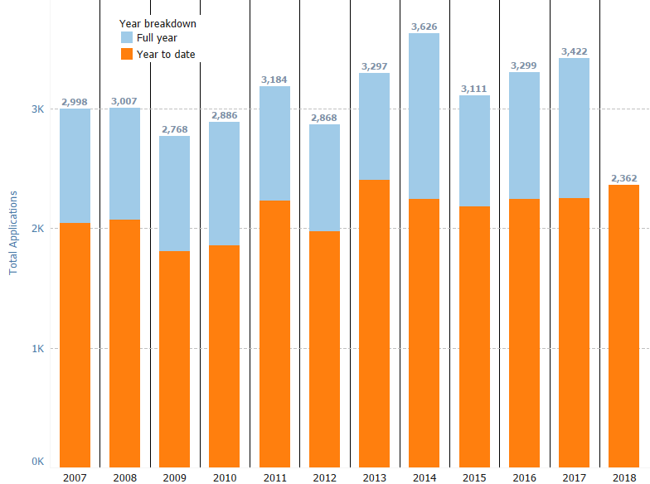
Applications

Slide 52
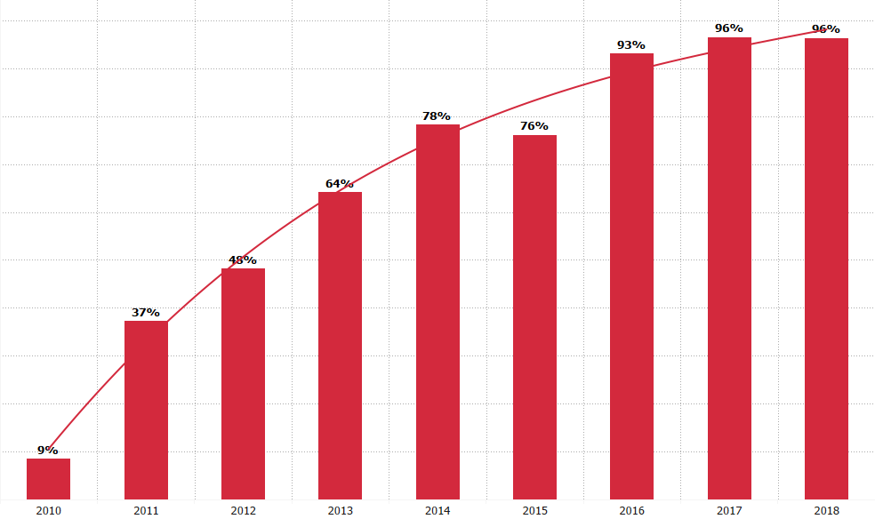
Online applications %

Slide 53
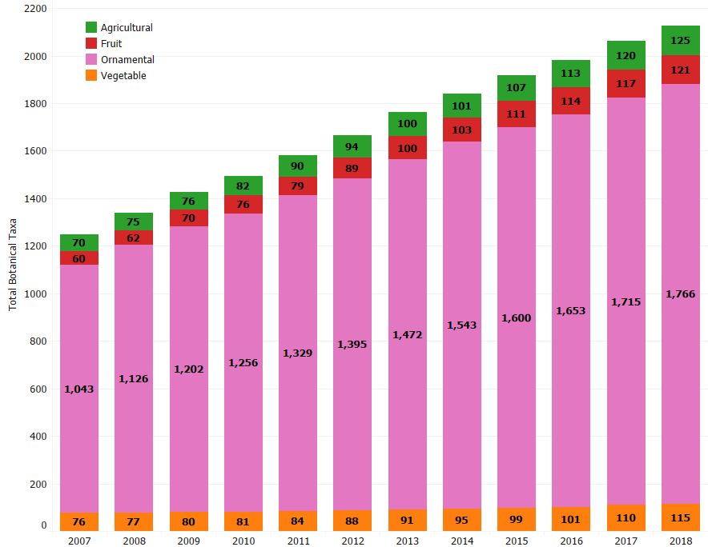
Evolution of botanical taxa

Slide 54
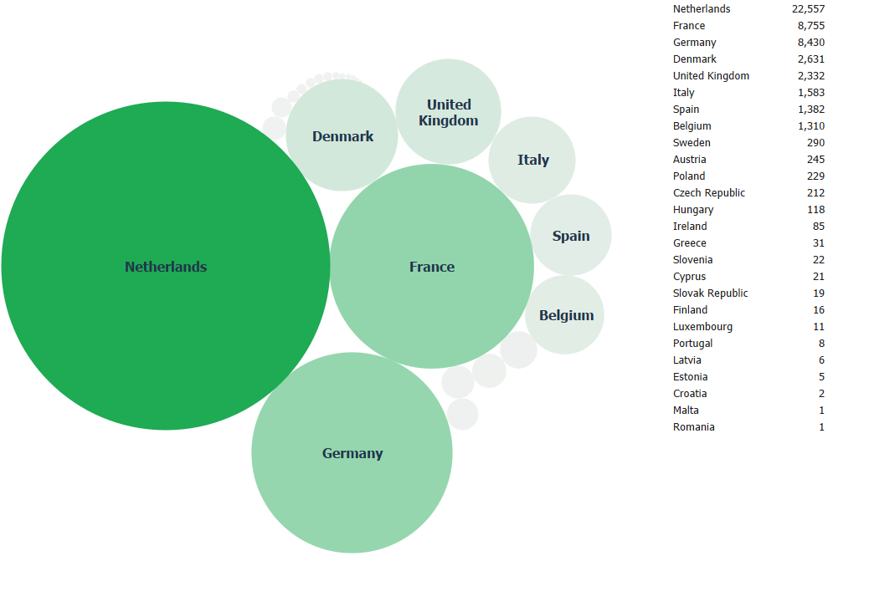
Applications EU : 1995-Present

Slide 55
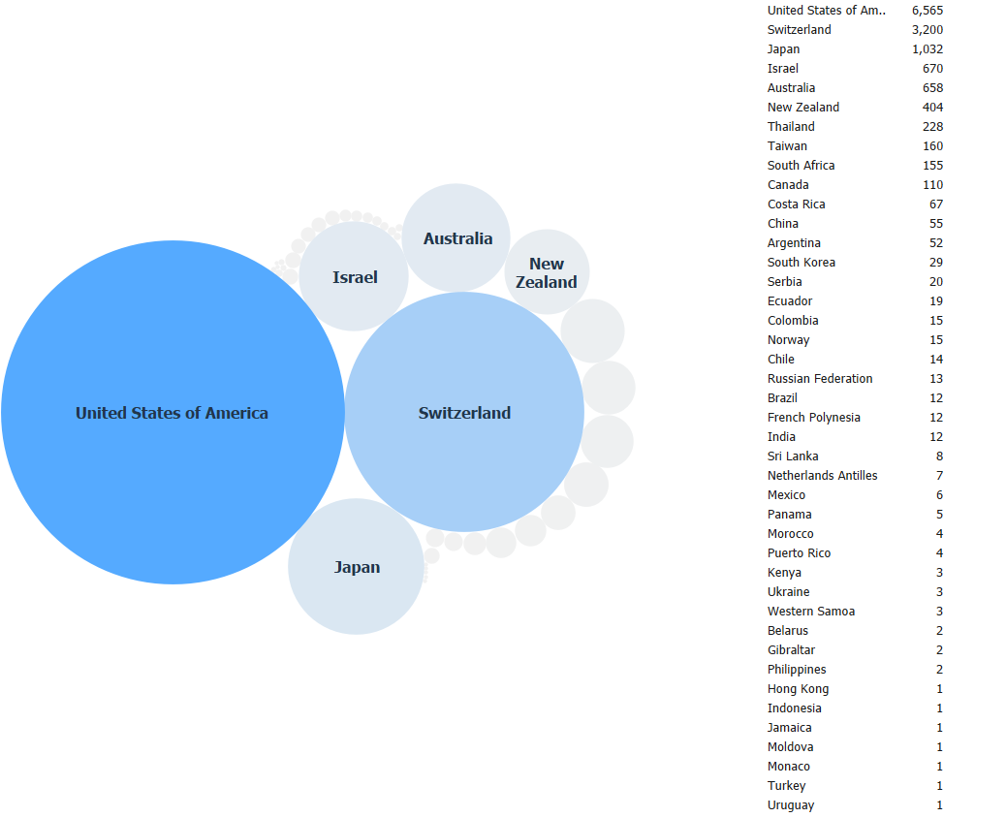
Applications non-EU : 1995-Present

Slide 56
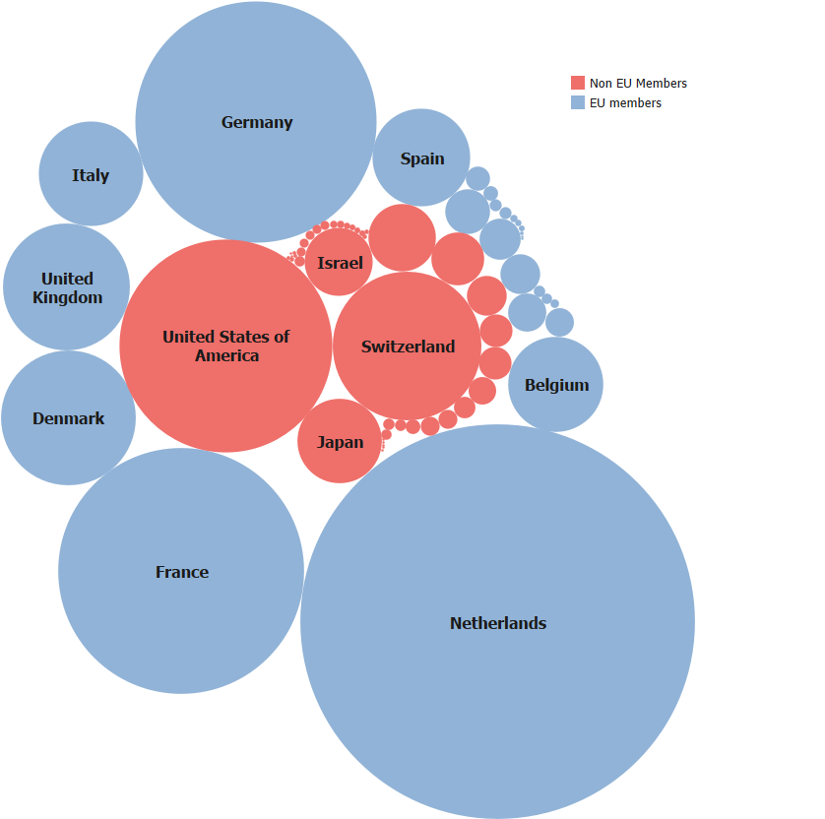
All Applications : 1995-Present

Slide 57
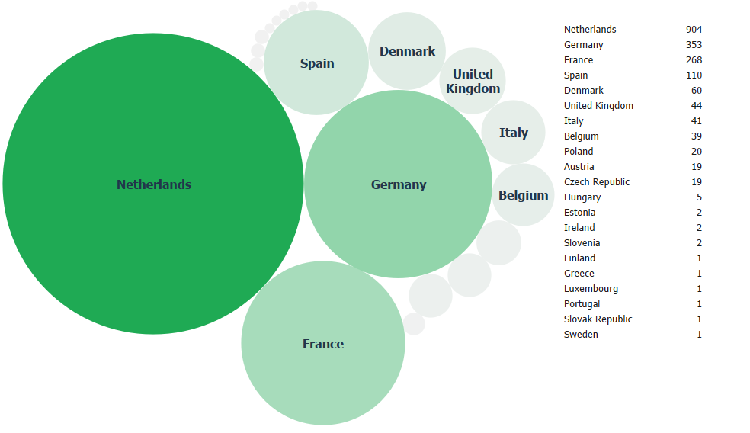
EU Applications 2018 to date

Slide 58
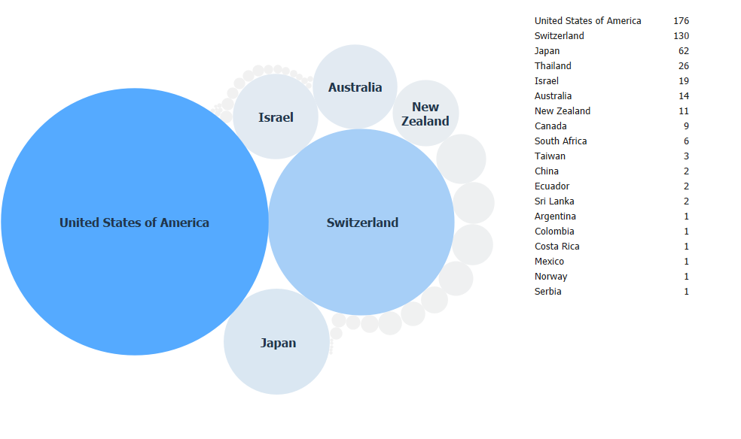
Non-EU Applications YTD 2018

Slide 59
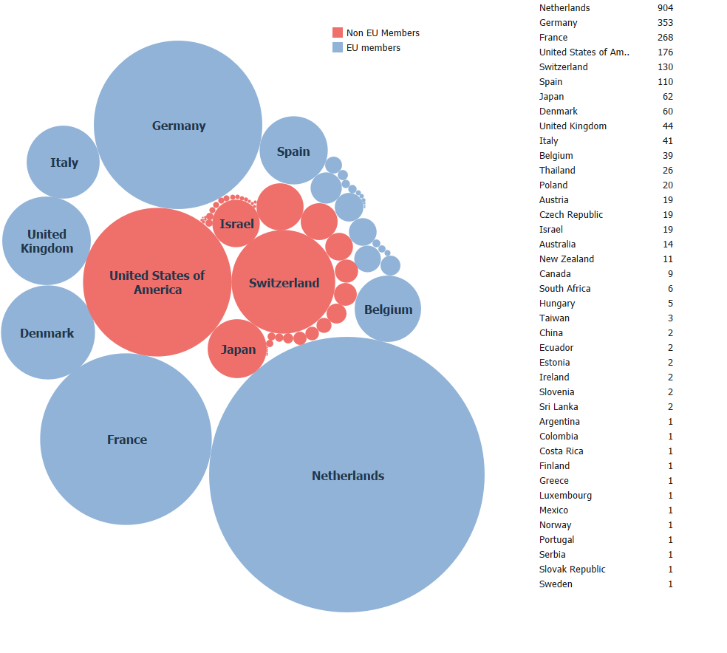
All Applications 2018 YTD

Slide 61
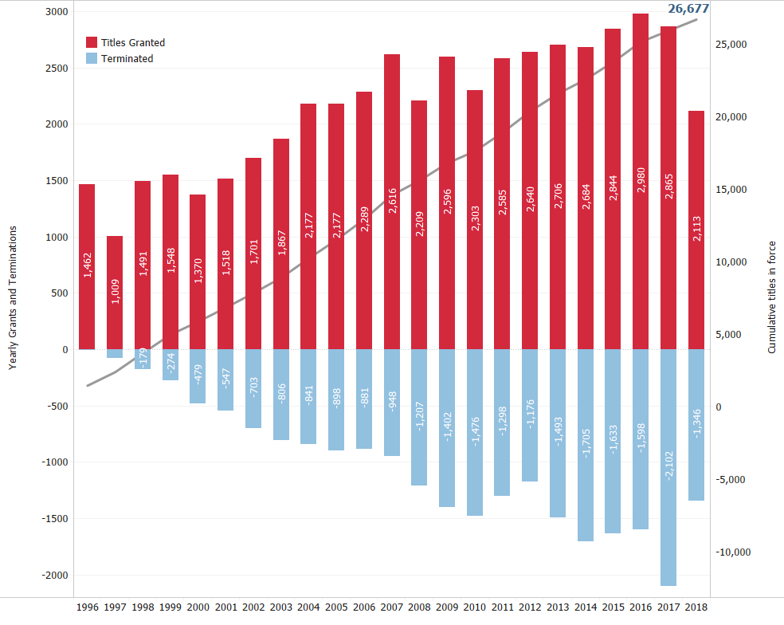
Grants and surrenders

Slide 64
OUTLINE
  I. Introduction to the European Union Plant Variety System
  II. The CPVO
  III. Community Plant Variety Rights
  IV. Application Procedure
  V. Proceedings before the Office and appeals
  VI. Enforcement
  VII. Statistics
  VIII. Final Remarks

Slide 65

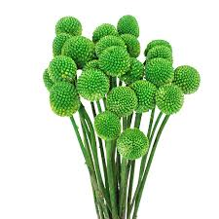


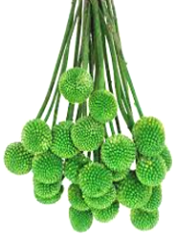
FINAL REMARKS
The daily activity of the CPVO results in:
    Efficiencies for applicants
    Less administration for national authorities
    Close co-operation with EOs, National Authorities, breeders’ associations and EU & international bodies
    Formative training through the frequent organisation of seminars

Slide 66


